Slide 1



Performance of Exotic Bamboo Species in Kenya
A rapid assessment of KEFRI bamboo trial sites
Victor Brias
Oprins Plant NV
UNIDO Consultant
EASTERN AFRICA BAMBOO PROJECT
funded by executed by supervised by

Slide 2
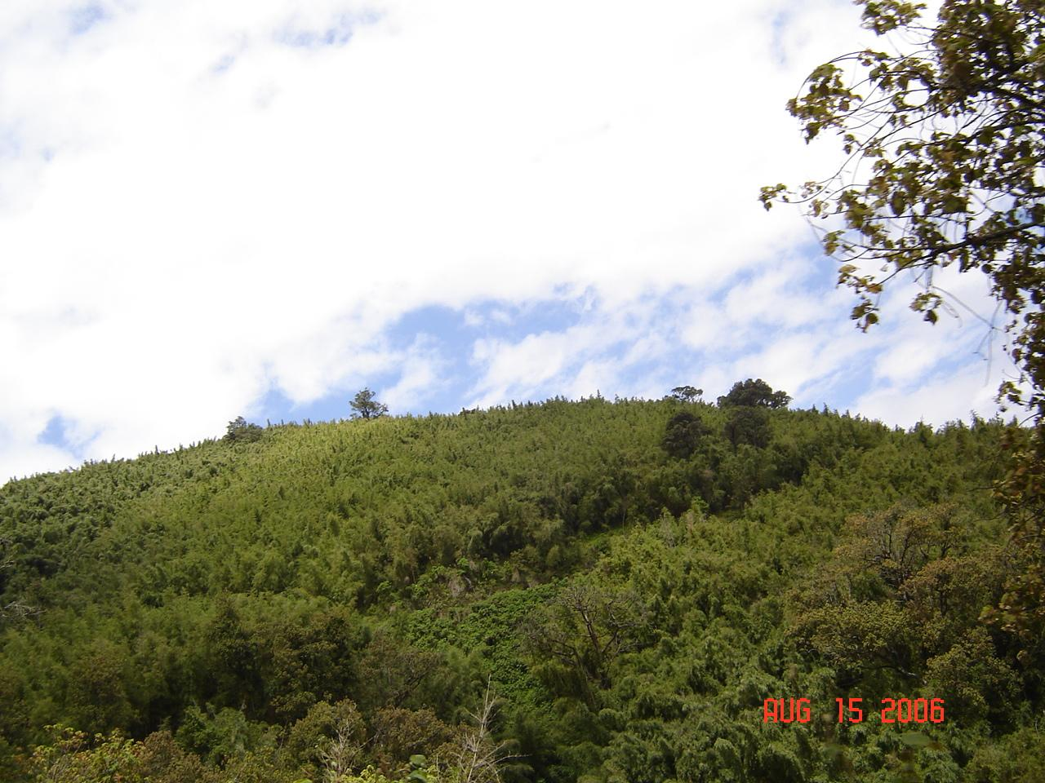
Background
Kenya logging ban – extended to Bamboo (Y. alpina) Forests
Trials of exotic bamboos by KEFRI in 1988-1990
Appraisal conducted by B. Kigomo & G. Sigu in 1995
Renewed interest in Bamboo due to ongoing projects (EABP)
Very Great Interest in Giant Bamboos !
Study conducted by V. Brias & G. Sigu in Aug. 2006
Field visits and analysis conducted between 7 Aug. – 6 Sept. 2006

Slide 3
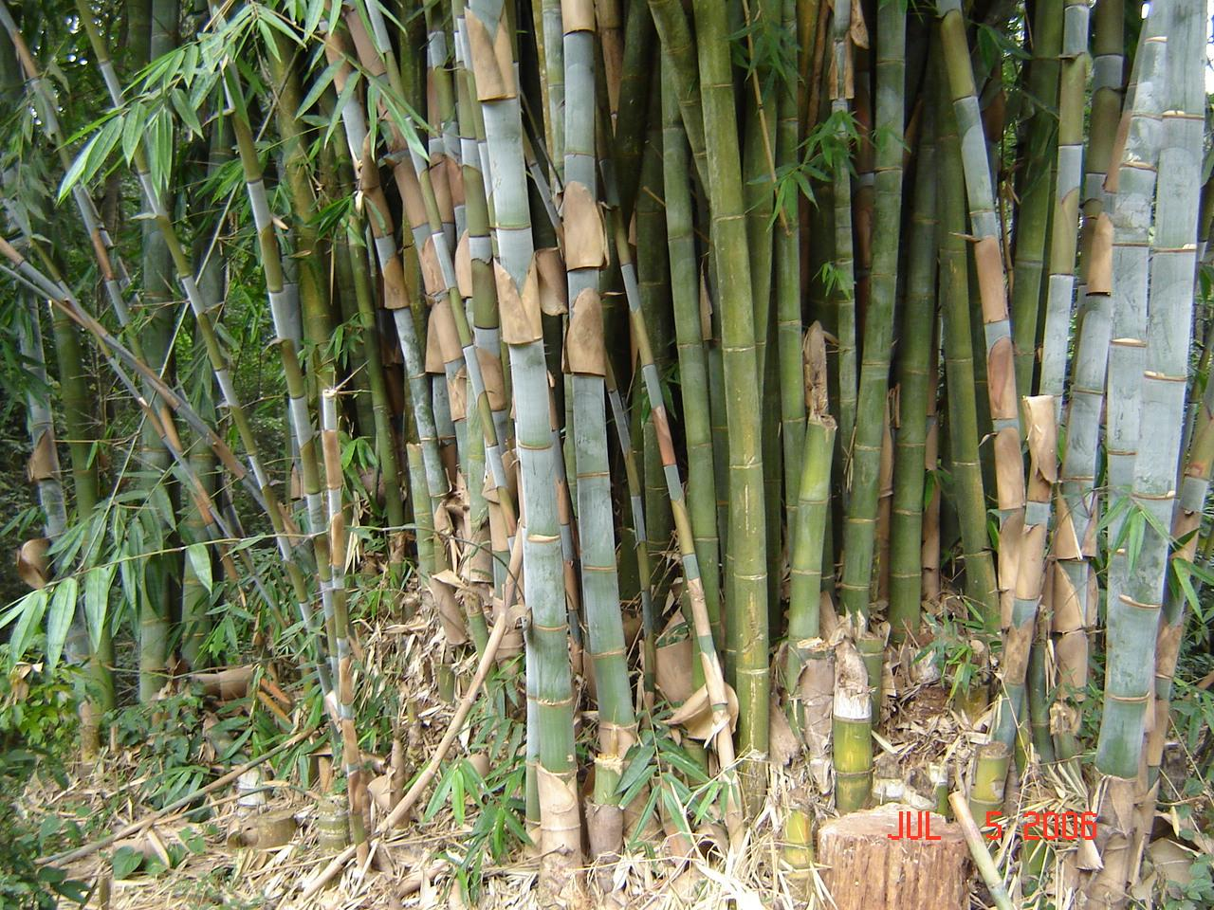

Slide 4
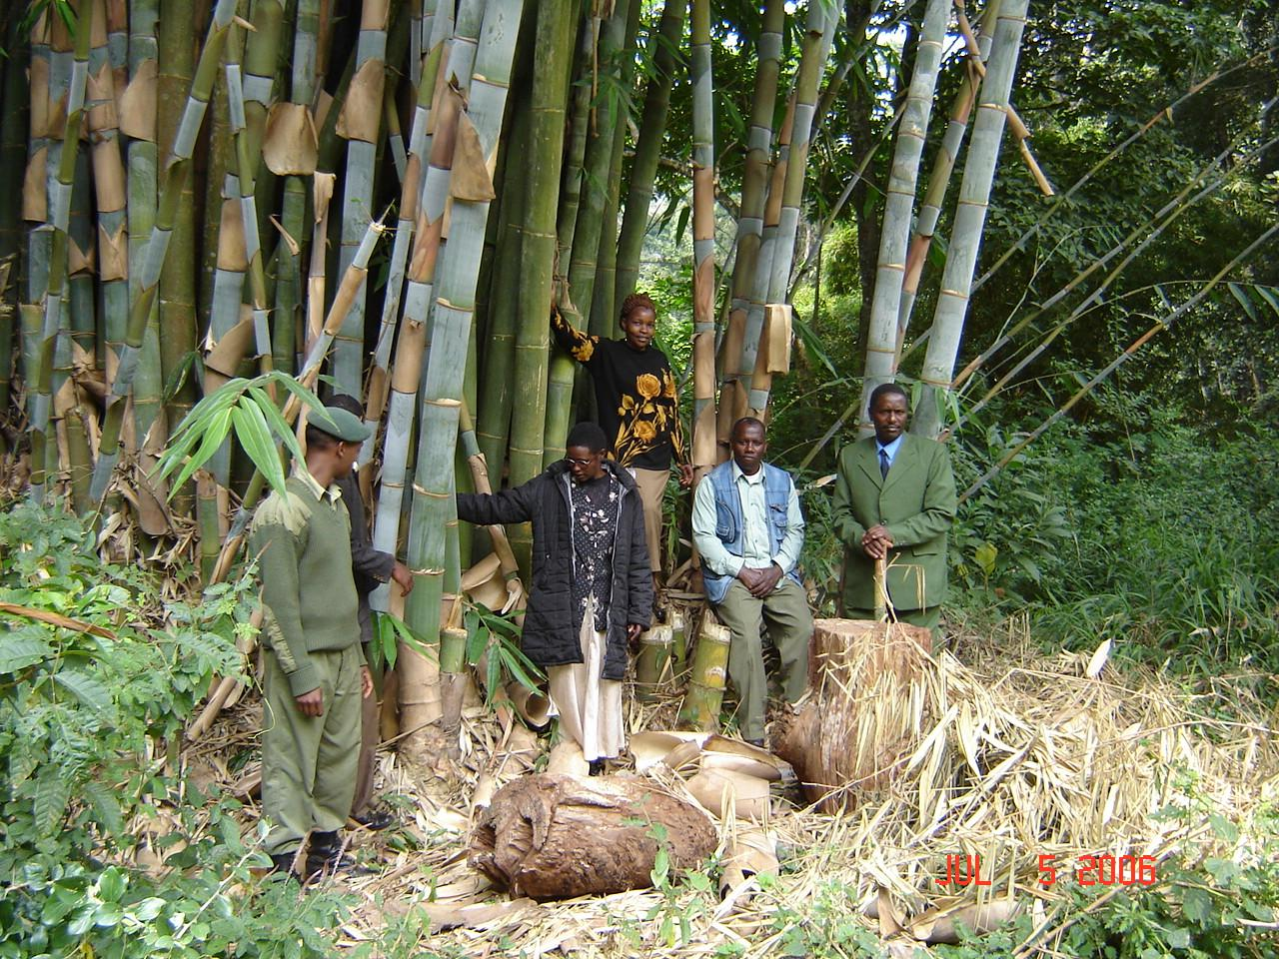

Slide 5
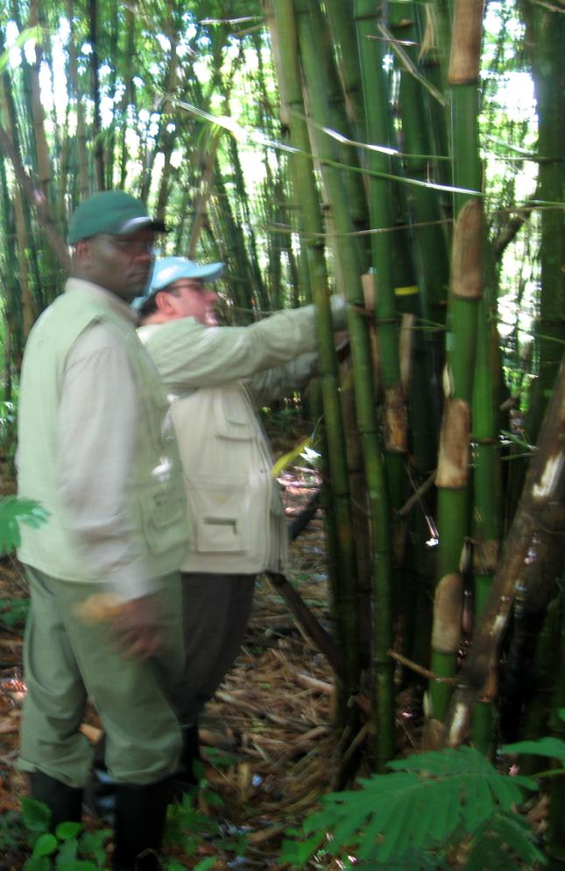
Objectives
Analyze the trial plantations in order to provide up to date information on species to site matching with specific focus on identifying suitable species for developing bamboo plantations in the Lake Region, highlands and coastal regions of Kenya.

Slide 6
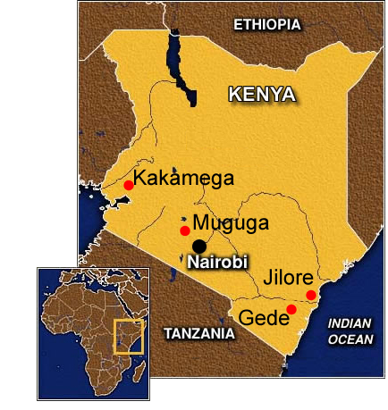
Trial Sites
Kakamega
Muguga
Jilore
Gede

Slide 7
KEFRI Bamboo Trial Locations
Site | KAKAMEGA | MUGUGA | GEDE | JILORE
Region | Lake Region | Highlands | Coastal (Malindi) | Coastal (Malindi)
Coordinates | 0°14’S / 36°38’E | 1°54’S / 34°15’E | 3°20’S / 40°5’E | 3°12’S / 39°55’E
Altitude | 1,675 m asl | 2,050 m asl | 50 m asl | 80 m asl
Temperature (min) | 17°C | 11°C | 22°C | 24°C
Temperature (max) | 33°C | 28°C | 33°C | 34°C
Annual Rainfall | 1100-1950 mm | 900-1500 mm | 900-1400 mm | 550-1000 mm
Soils | Dark Brown Loams | Deep Dark Red Clay Loams | Sandy White Loams | Sandy-red compact sandy soils
Source: Kigomo & Sigu, 1996.

Slide 8
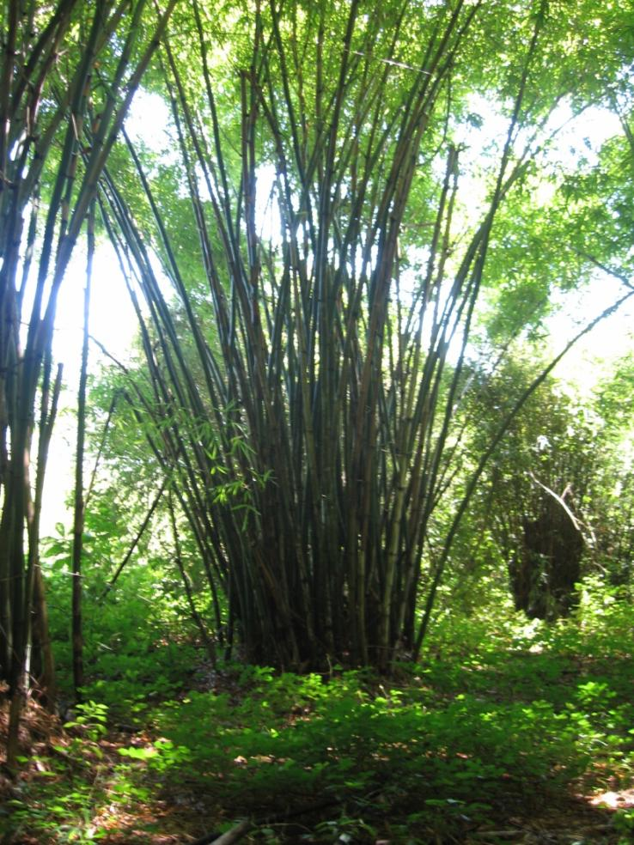
Species planted at KEFRI Trials
Bambusa vulgaris
Bambusa bambos
Bambusa tulda
Cephalostachyum pergracile
Dendrocalamus asper
Dendrocalamus brandisii
Dendrocalamus giganteus
Dendrocalamus hamiltonii
Dendrocalamus membranaceus
Dendrocalamus strictus
Thyrsostachys siamensis
Phyllostachys species

Slide 9
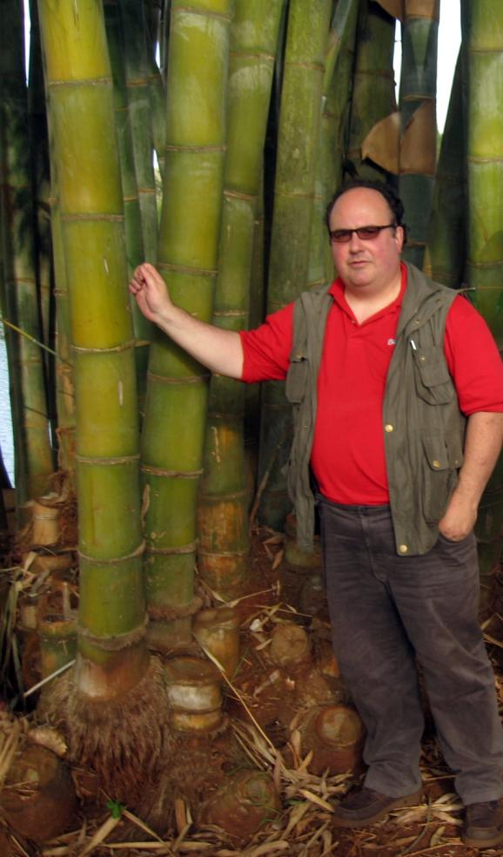
Observations in 2006
5 x 5 planting for all species
  Inadequate for large bamboos
  Suitable for some species (T. siamensis)
  Sites were unmanaged
  no systematic harvesting
  Weeds
  rotting / dead culms
  fire damage in some areas
Plots not marked with species names
  - Some species not located/identified
  D. giganteus, Ph. pubescens, etc.
  Mix up of species at time of planting
Noticable difference in species growth
  Highland (Kakamega /Muguga)
  Coastal (Gede / Jilore )

Slide 10
Methodology
Sampling Clumps in each site
Count new shoots / culms per clump
Calculate average culms/clump per species / location
Measure height / diameter / thickness
Mathematical estimate of average dry weight of culms using 0.65 g/cm³ specific gravity as working assumption (less accurate than weighing the culms ! )
Estimate potential yield in tons/ha (dry basis) based on harvesting 25% of culms (1/4 of standing culms or culms > 3 years old.
Benchmark results with published info about species in native habitats

Slide 11
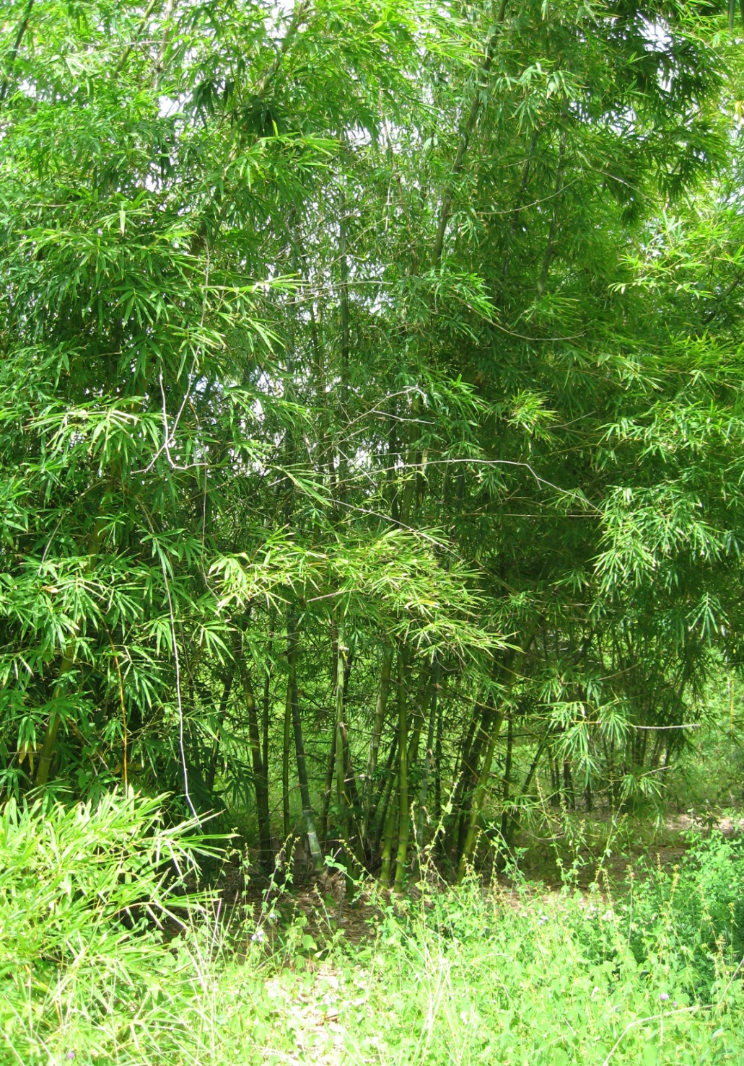
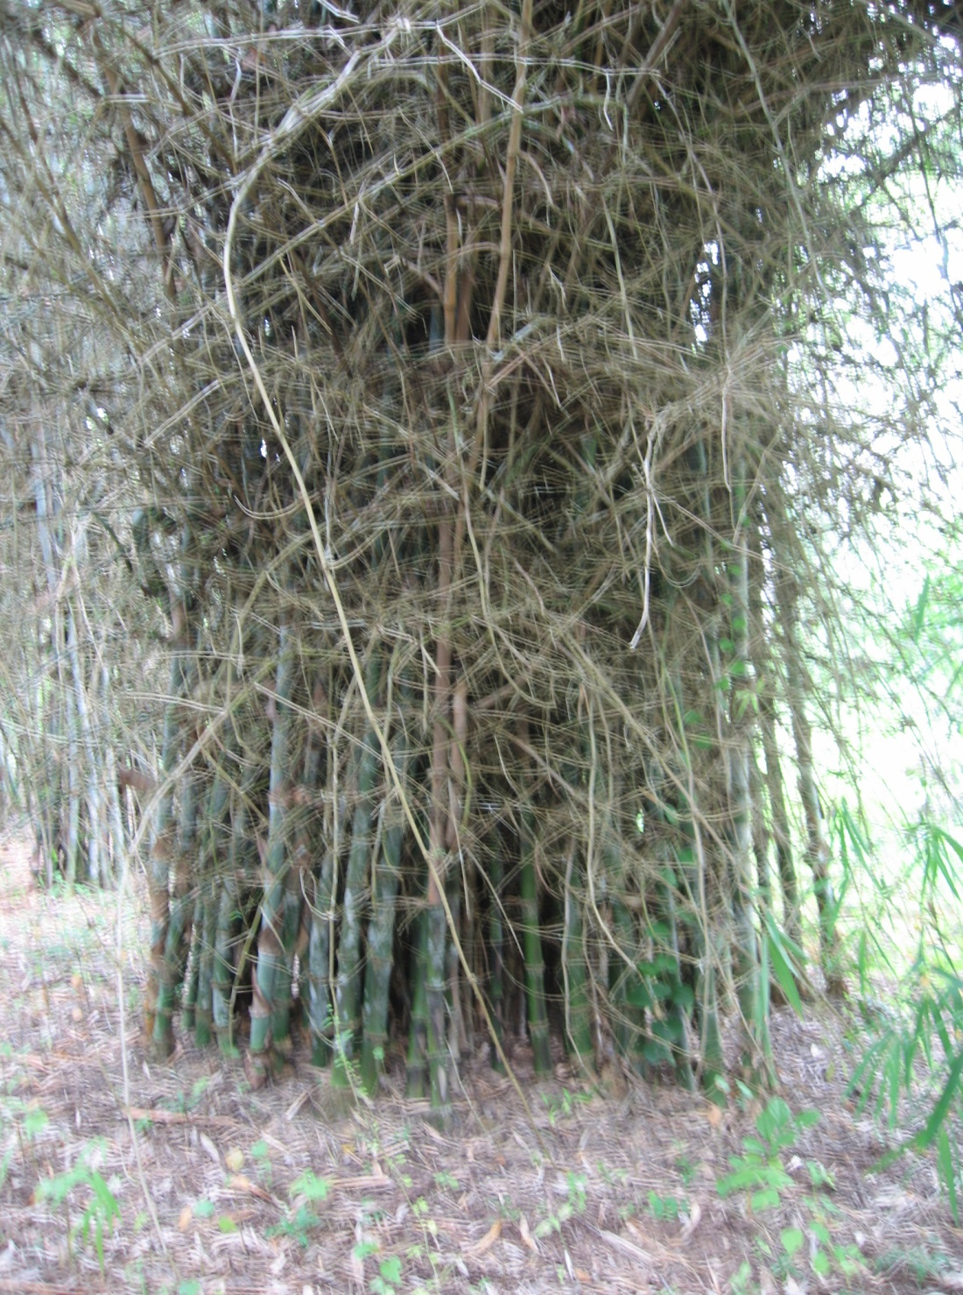

Slide 12
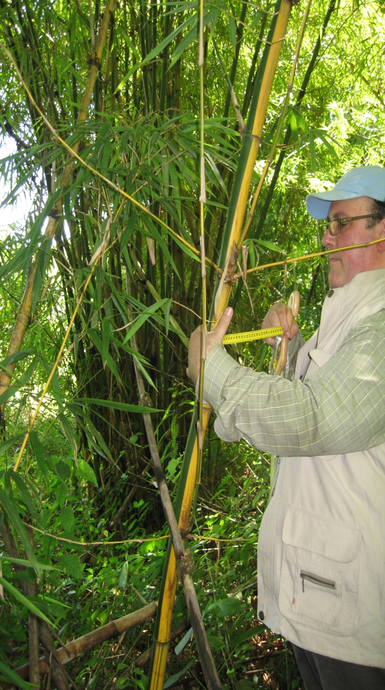
Methodology
Sampling Clumps in each site
Count new shoots / culms per clump
Calculate average culms/clump per species / location
Measure height / diameter / thickness
Mathematical estimate of average dry weight of culms using 0.65 g/cm³ specific gravity as working assumption (less accurate than weighing the culms!)
Estimate potential yield in tons/ha (dry basis) based on harvesting 25% of culms (1/4 of standing culms or culms >3 years old.)
Gauging results using info about species in native habitats as a benchmark

Slide 13
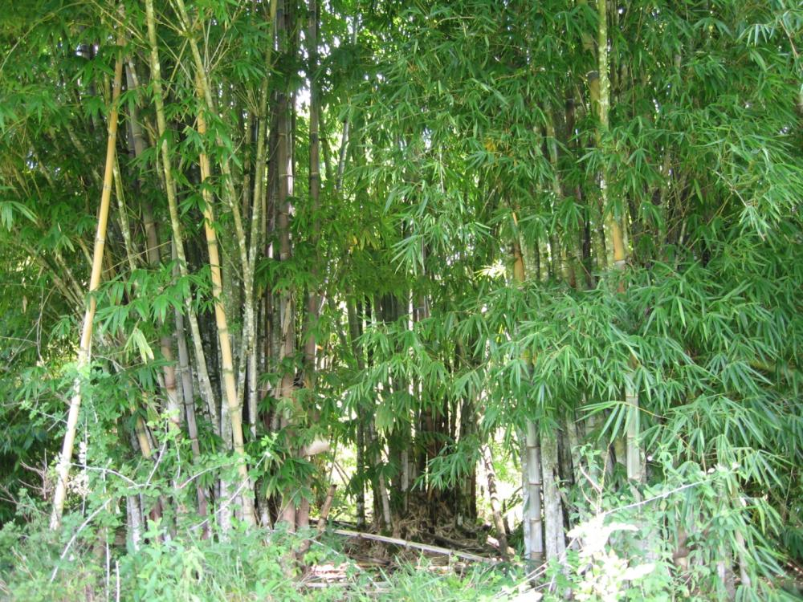

Slide 14
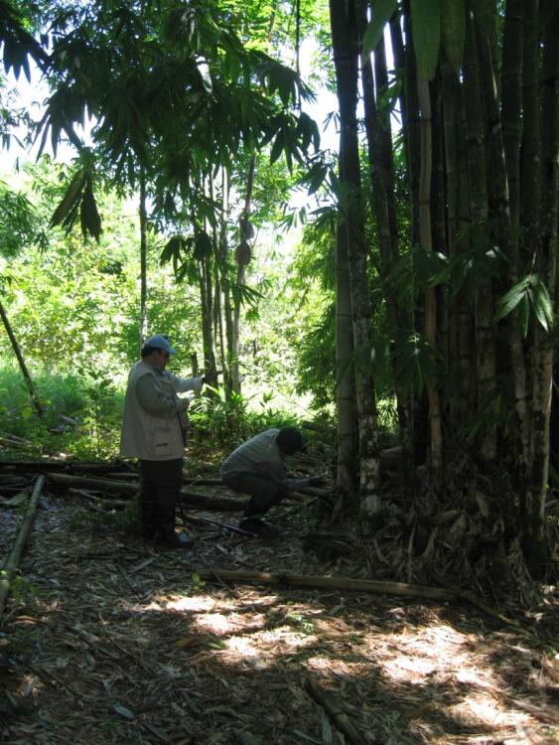
Methodology cont.
Mathematical estimate of average dry weight of culms using 0.65 g/cm³ specific gravity as working assumption (less accurate than weighing the culms!)
Estimate potential yield in tons/ha (dry basis) based on harvesting 25% of culms (1/4 of standing culms or culms >3 years old.)
Benchmark results with published info about species in native habitats

Slide 15
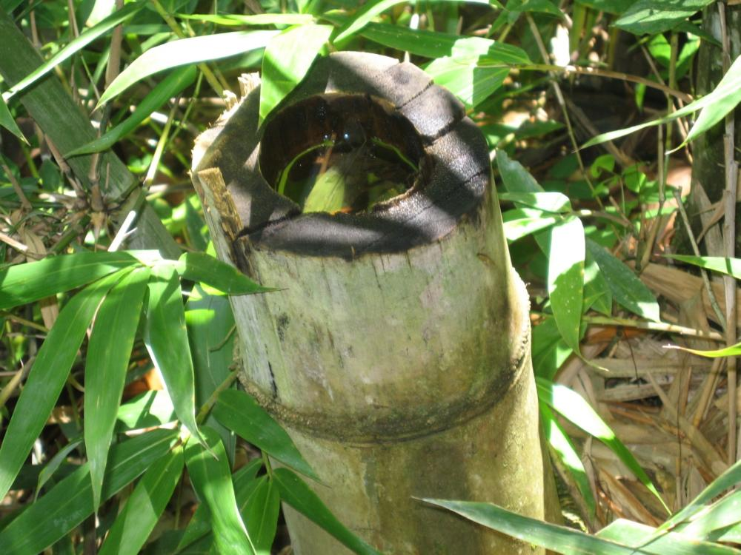

Slide 16
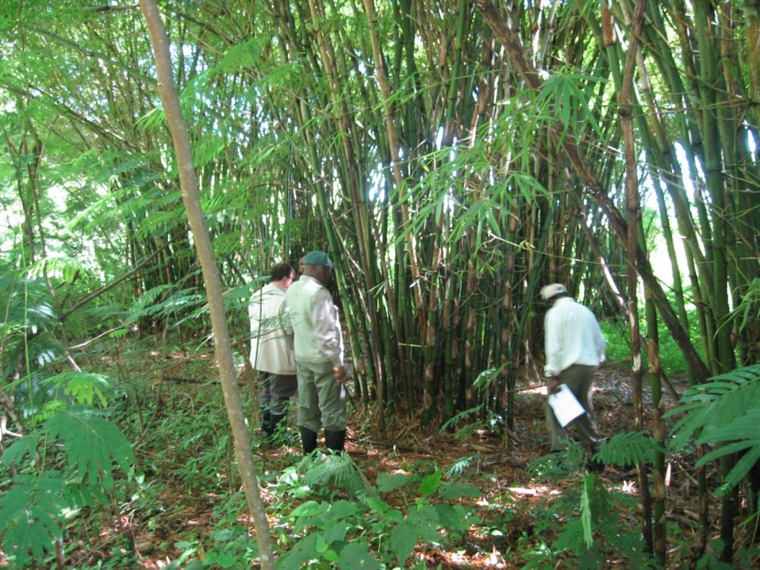

Slide 17
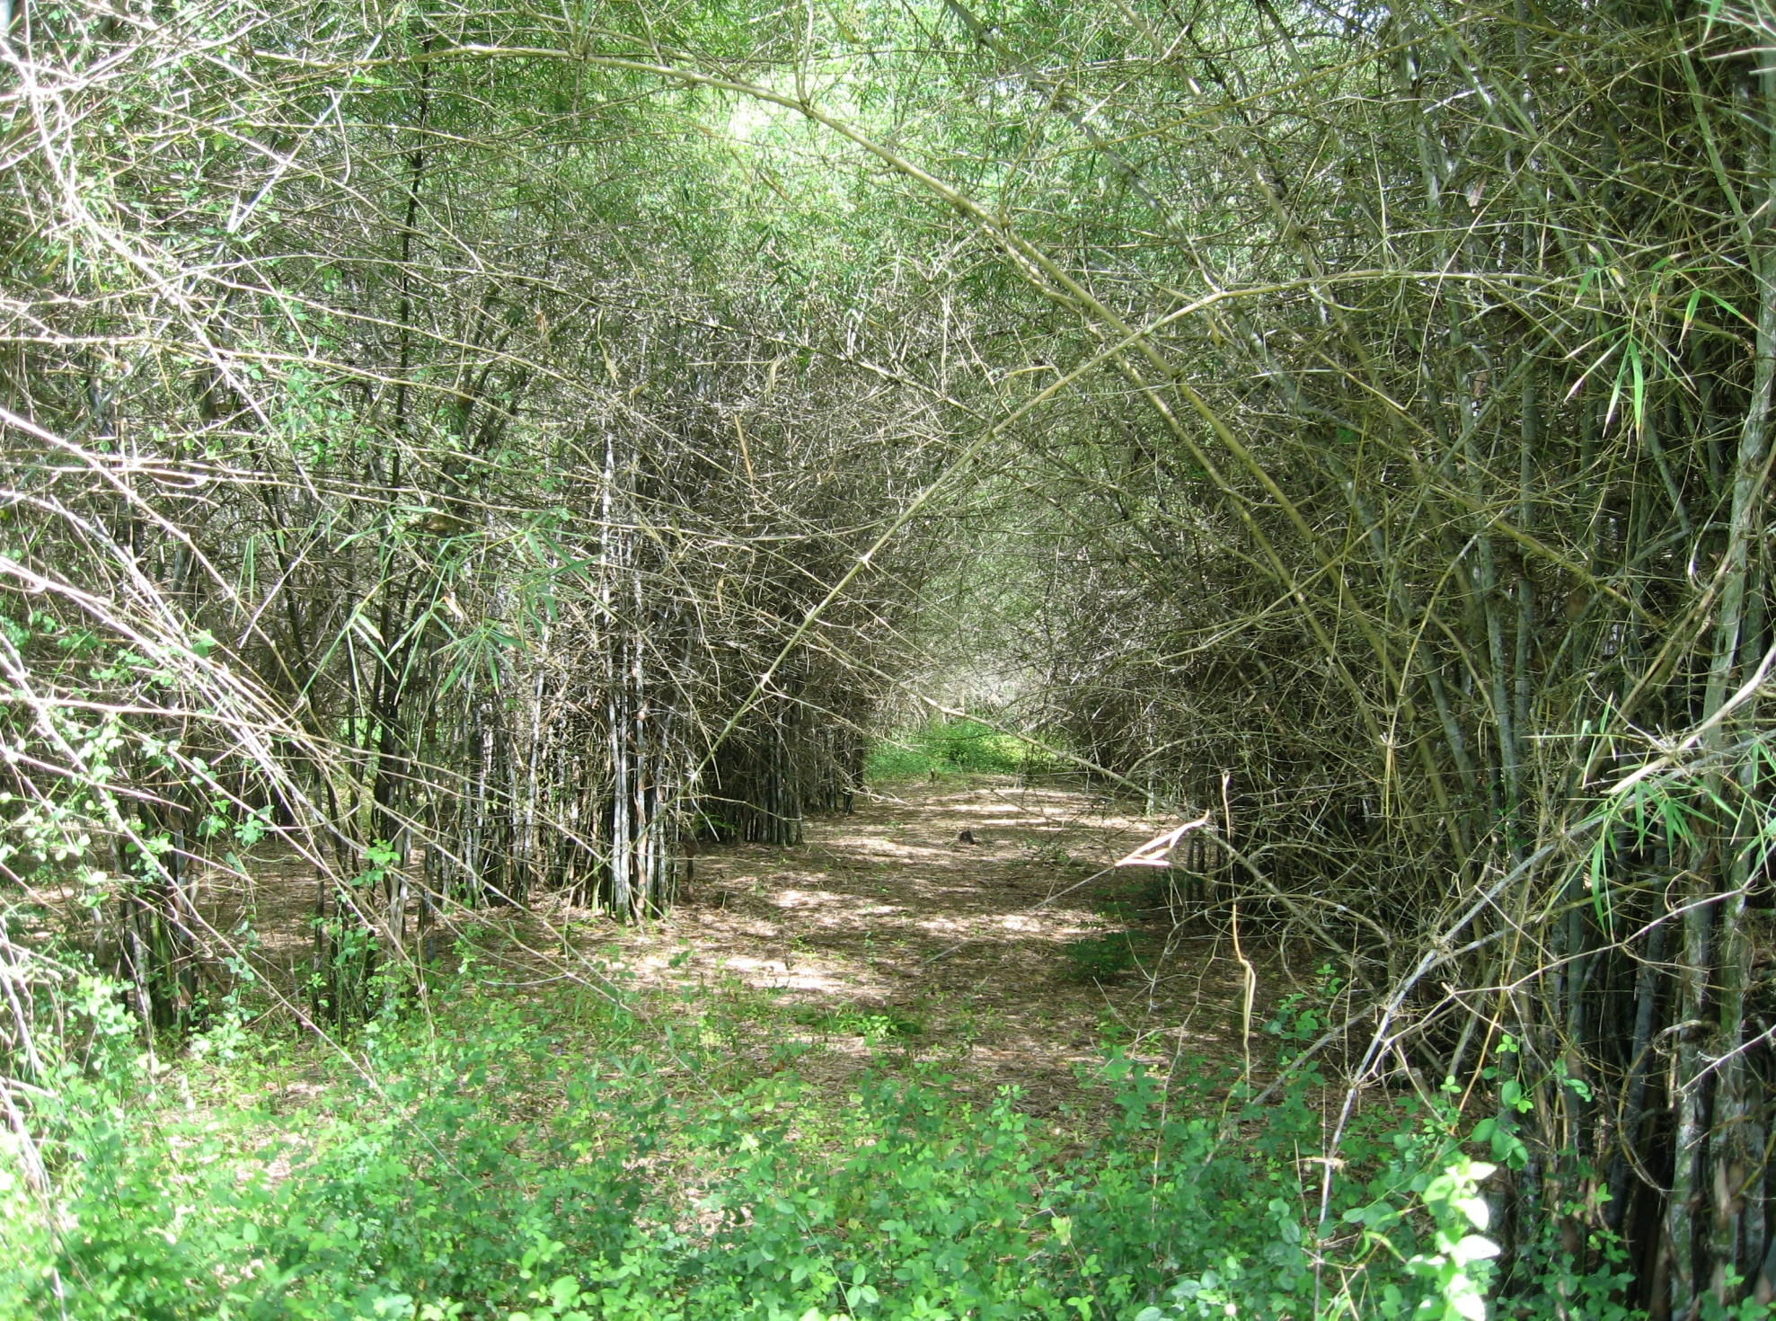

Slide 18
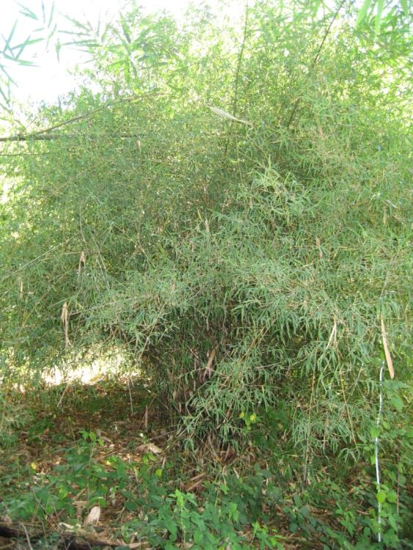
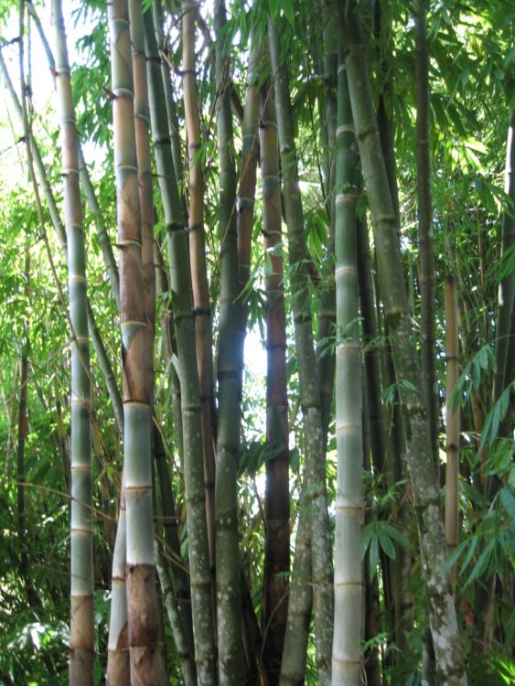
Results

Slide 19
RESULTS Trial Site : Gede |  |  |  | Performance in Asia |  |  | Comparative Performance
SPECIES | H (m) | D (cm) | WT (mm) | H (m) | D (cm) | WT (mm) | H | D | WT
D. brandisii | 15 | 10 | 18 | 25 | 12 | 18 | 60% | 83% | 100%
B. vulgaris | 8 | 6 | 8 | 15 | 7 | 10 | 53% | 86% | 80%
T. siamensis | 6 | 2.5 | 9.4 | 9 | 4 | 15 | 67% | 63% | 63%
D. strictus | 9 | 3 | 11.3 | 10 | 8 | 30 | 90% | 38% | 38%
D. membranaceus | 9 | 5 | 5 | 18 | 10 | 10 | 50% | 50% | 50%
D. hamiltonii | 9 | 5 | 7.5 | 20 | 10 | 15 | 45% | 50% | 50%
B. bambos | 9 | 5 | 7.5 | 20 | 12 | 18 | 45% | 42% | 42%

Slide 20
RESULTS Trial Site : JILORE |  |  |  | Performance in Asia |  |  | Comparative Performance
SPECIES | H (m) | D (cm) | WT (mm) | H (m) | D (cm) | WT (mm) | H | D | WT
D. membranaceus | 12 | 7 | 10 | 18 | 10 | 10 | 67% | 70% | 100%
B. bambos | 15 | 9 | 13.5 | 20 | 12 | 18 | 75% | 75% | 75%
D. hamiltonii | 10 | 6 | 9 | 20 | 10 | 15 | 50% | 60% | 60%

Slide 21
RESULTS Trial Site: KAKAMEGA |  |  |  | Performance in Asia |  |  | Comparative Performance
SPECIES | H (m) | D (cm) | WT (mm) | H (m) | D (cm) | WT (mm) | H | D | WT
B. vulgaris | 8 | 7 | 9 | 15 | 7 | 10 | 53% | 100% | 90%
D. brandisii | 12 | 11 | 15 | 25 | 12 | 18 | 48% | 92% | 83%
D. strictus | 5 | 7 | 25 | 10 | 8 | 30 | 50% | 88% | 83%
D. hamiltonii | 10 | 10 | 10 | 20 | 10 | 15 | 50% | 100% | 67%
D. membranaceus | 7 | 7 | 8 | 18 | 10 | 10 | 39% | 70% | 80%
T. siamensis | 5 | 2.5 | 9 | 9 | 4 | 15 | 56% | 63% | 60%
B. tulda | 6 | 7 | 10 | 18 | 10 | 17 | 33% | 70% | 59%
B. bambos | 4 | 7 | 10 | 20 | 12 | 18 | 20% | 58% | 56%

Slide 22
RESULTS Trial Site: MUGUGA |  |  |  | Performance in Asia |  |  | Comparative Performance
SPECIES | H (m) | D (cm) | WT (mm) | H (m) | D (cm) | WT (mm) | H | D | WT
B. vulgaris | 7 | 7 | 9 | 15 | 7 | 10 | 47% | 100% | 90%
D. brandisii | 10 | 10 | 18 | 25 | 12 | 18 | 40% | 83% | 100%
C. pergracile | 10 | 6 | 5 | 18 | 8 | 6 | 56% | 75% | 83%
D. hamiltonii | 9 | 10 | 10 | 20 | 10 | 15 | 45% | 100% | 67%
D. strictus | 5 | 6 | 23 | 10 | 8 | 30 | 50% | 75% | 77%
T. siamensis | 5 | 3 | 9 | 9 | 4 | 15 | 56% | 75% | 60%
B. tulda | 6 | 7 | 10 | 18 | 10 | 17 | 33% | 70% | 59%
D. membranaceus | 7 | 6 | 6 | 18 | 10 | 10 | 39% | 60% | 60%
B. bambos | 4 | 6 | 9 | 20 | 12 | 18 | 20% | 50% | 50%

Slide 23
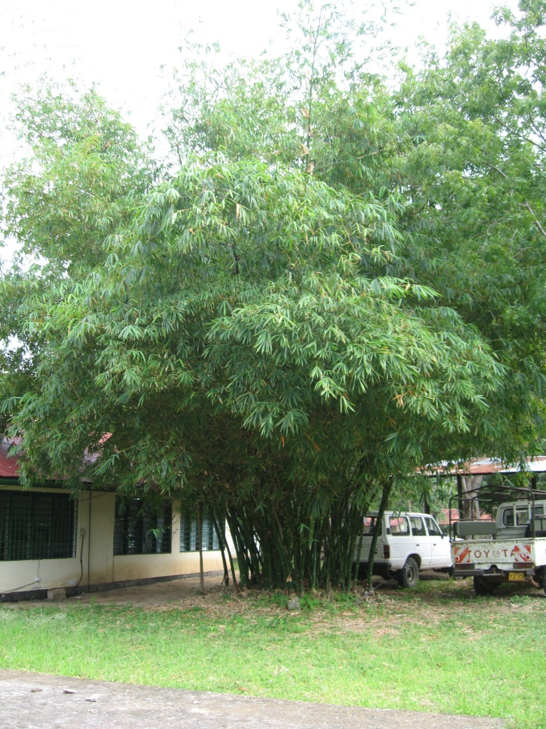
CONCLUSIONS
Exotic Species Planted by KEFRI have shown reasonably good adaptability in various sites in Kenya.
Culm Height is generally stunted, especially for giant bamboo species
Notably good performance of B. bambos in coastal region (drought resistance).

Slide 24
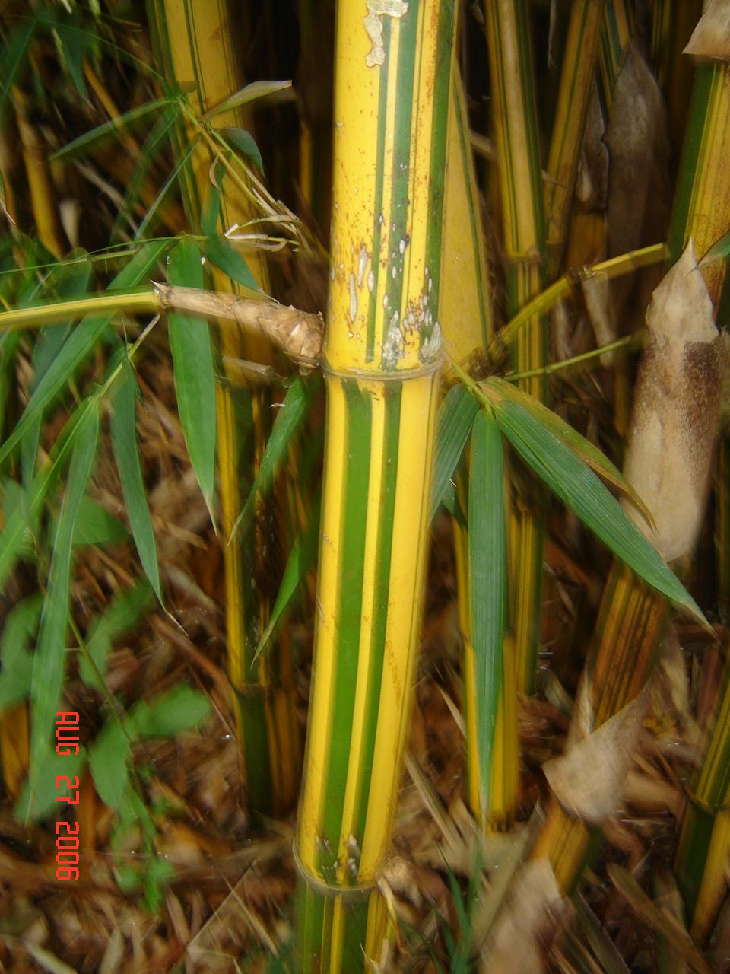
CONCLUSIONS
Very Good Performance of B. vulgaris in Lake Region & T. siamensis in Highlands
Exotic Species are especially valuable in Coastal regions (Gede / Jilore) due to demand by tourism industry in Malindi / Mombasa region

Slide 25
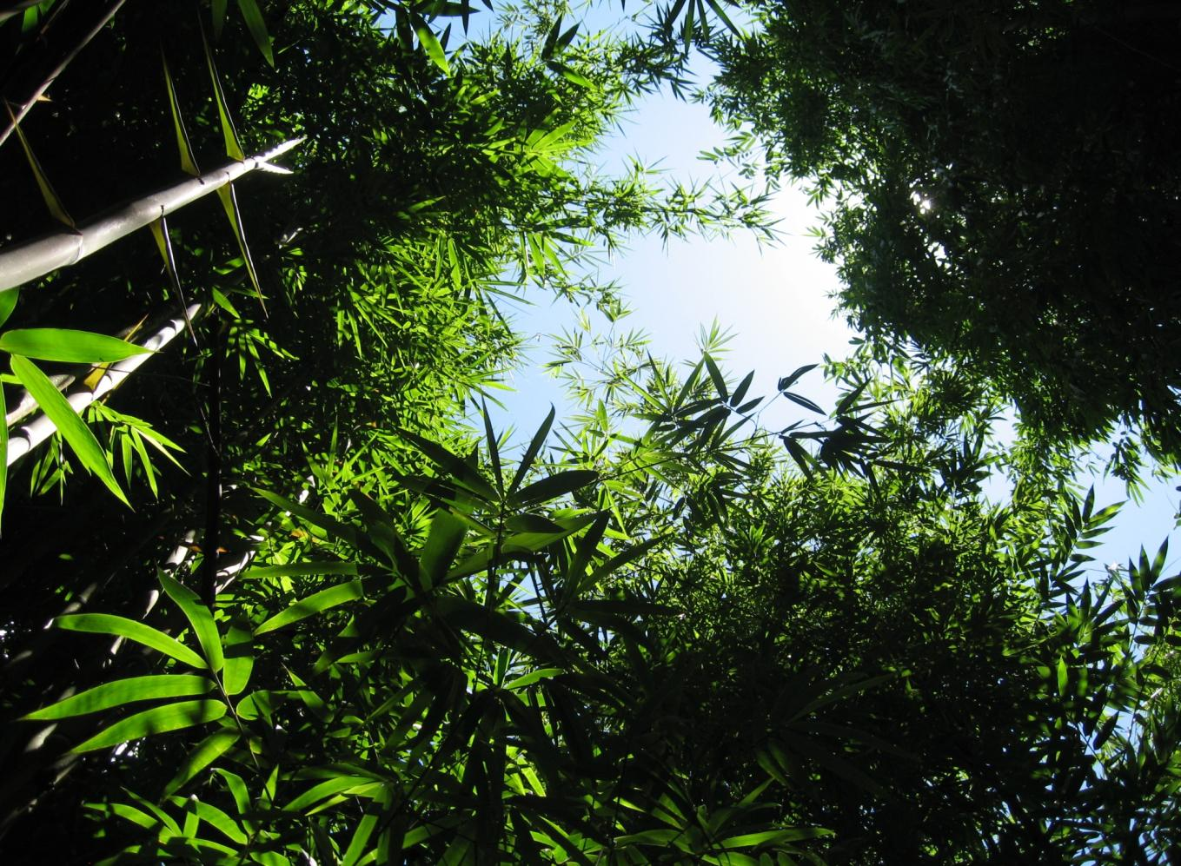
Thank You !

Slide 26
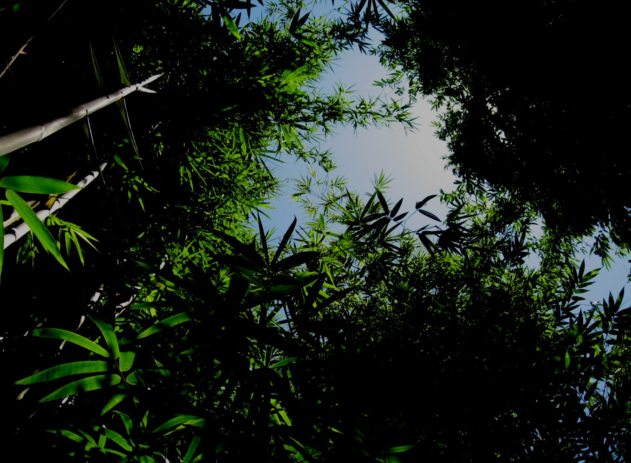
More info:
Victor Brias
Oprins Plant NV
www.oprins.com
www.bambunusaverde.com

