Slide 1
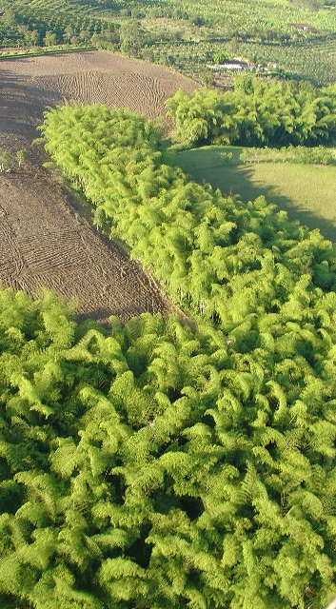


Guadua angustifolia forestry nucleus in Colombia: Contribution to environmental preservation and local social development
Ximena Londoño
Colombian Bamboo Society

Slide 2
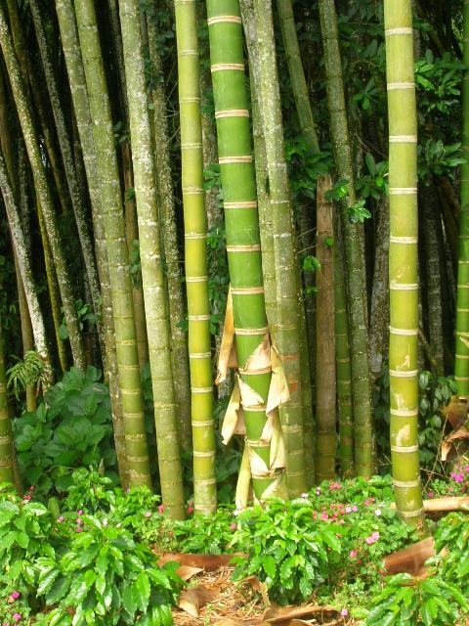
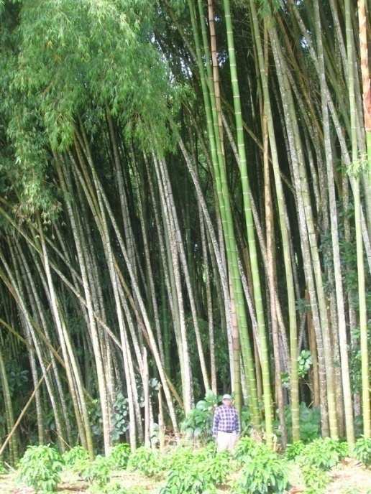
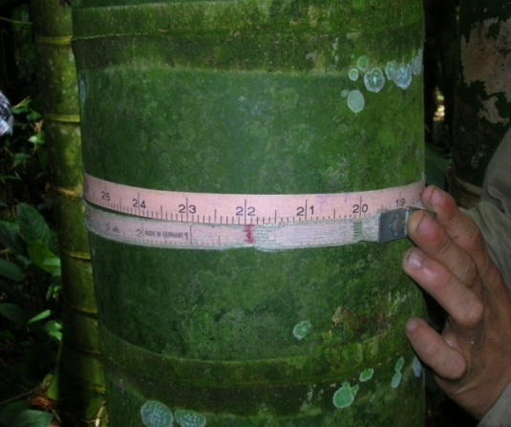
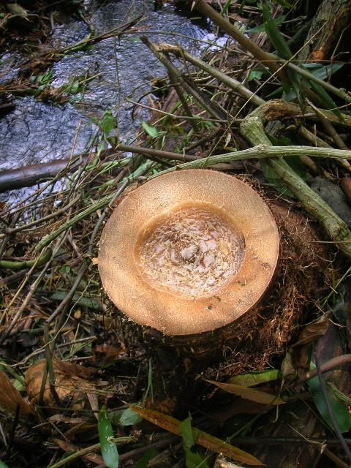

Guadua angustifolia
Kunth
It is considered to be among the 20 best bamboos in the world.
The most traditional used and the most economical important native bamboo in America.
The biggest bamboo in America: reaches up to 30 m tall and 25 cm in diam.

Slide 3
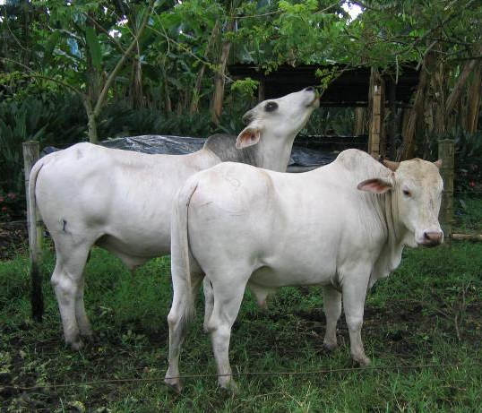
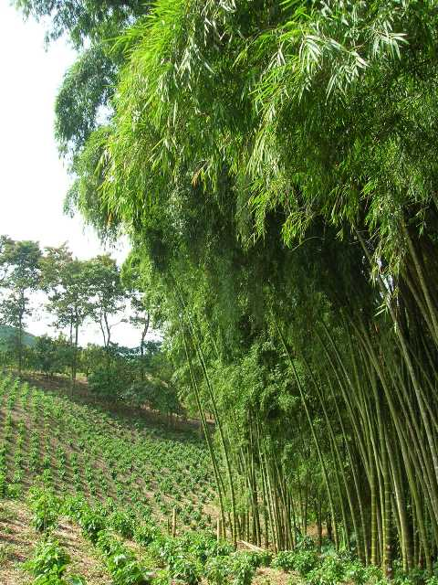
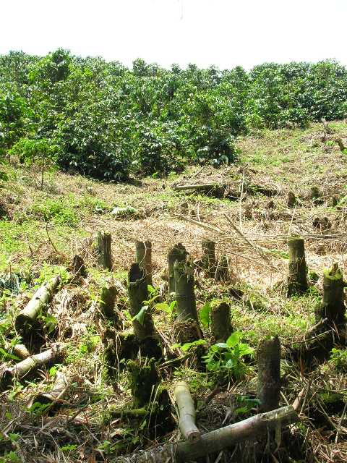
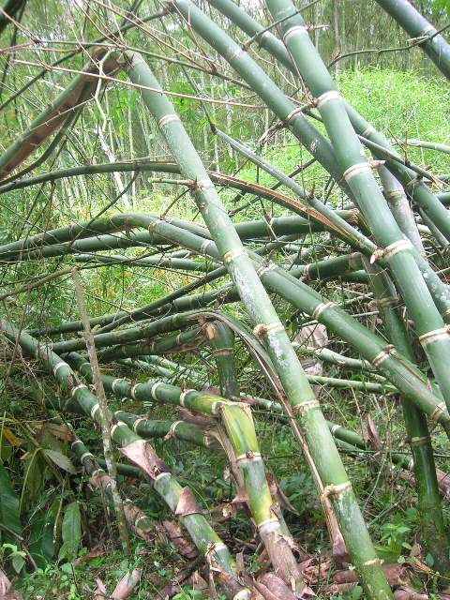

Aspects that contribute to reduce
the area in guaduales
Division of property due to inheritance processes
Change of land ownership
Atypical climatic phenomena
Low profits for the farmers

Slide 4
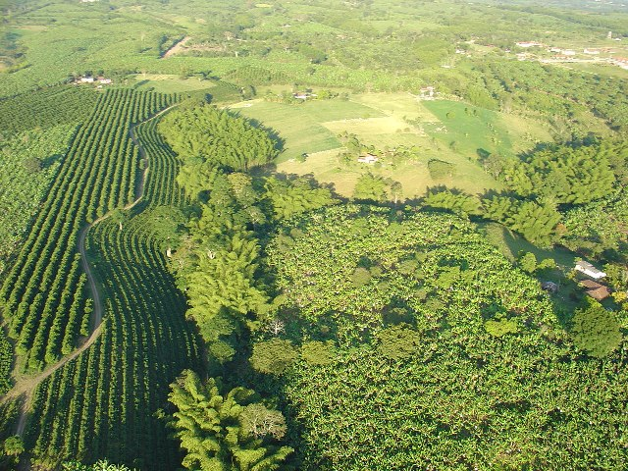
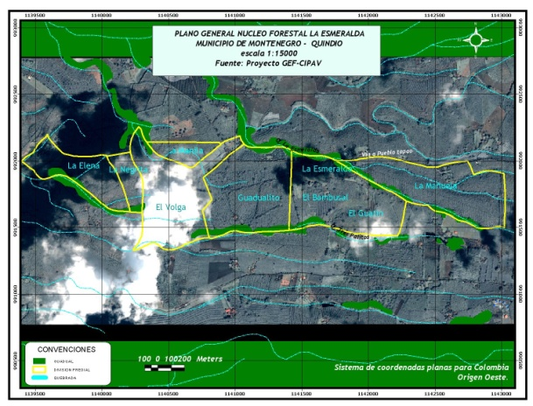

“LA ESMERALDA” Guadua Forestry Nucleous
OBJECTIVES
To integrate the area planted in guadua having different owners under one same figure.
To better manage and improve the forestry quality of the plantations.
To ensure a better quality and better price for the raw material.
To guarantee protection of the water resources and biodiversity.
To generate employment.
To provide support and incentives for the research processes.
To strengthen the social and entrepreneurial organizations existing in the region.

Slide 5
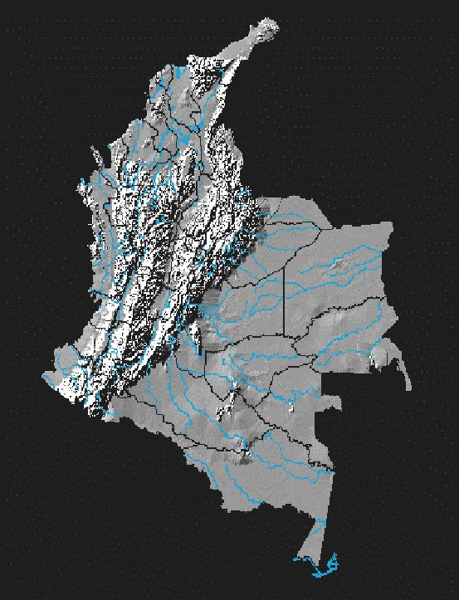
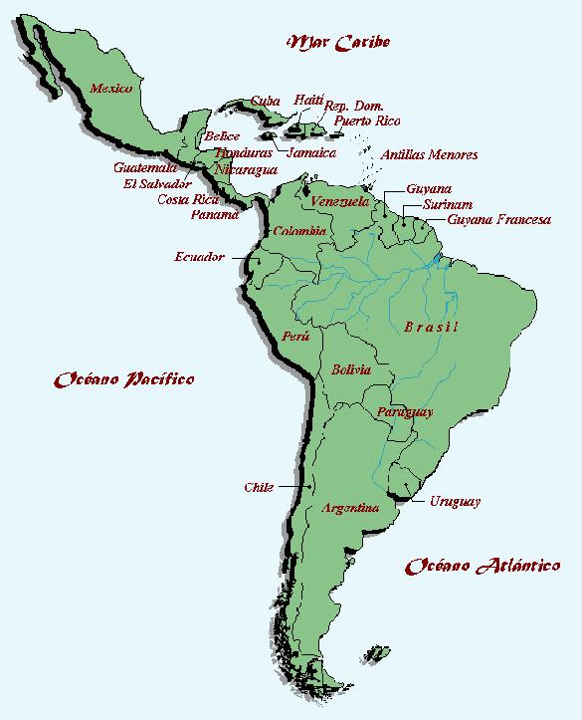
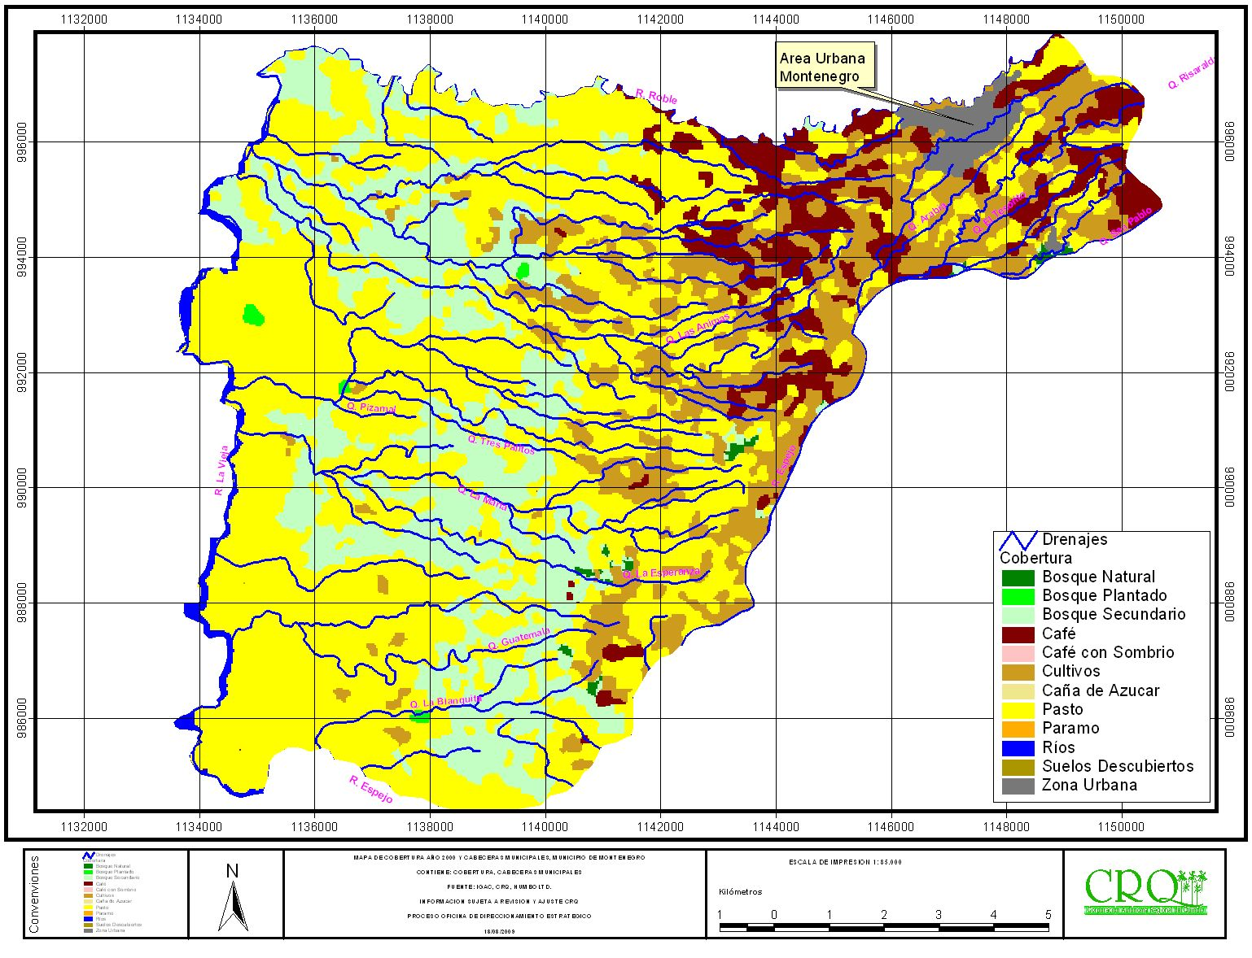

LOCATION OF GUADUA FORESTRY NUCLEOUS LA ESMERALDA - GFNLE
Quindío
Quindío
Colombia
GFNLE

Slide 6
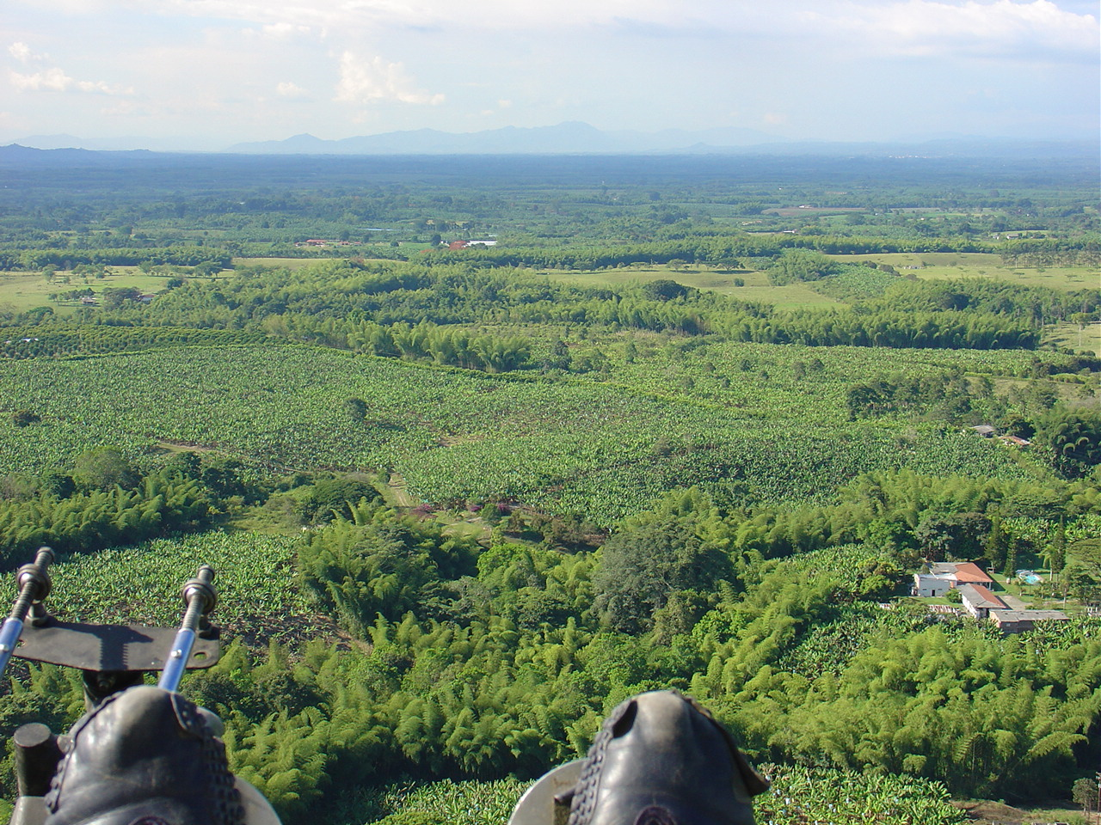
Area of the GFNLE
Farms 11 | Farms Area (ha) | Area (ha) of the Guadua Plantation |  | Percentage of the area in Guaduales (%)
 |  | Natural | Cultivated
TOTAL | 315,7 | 26,94 | 0,8 | 8,8

Slide 7
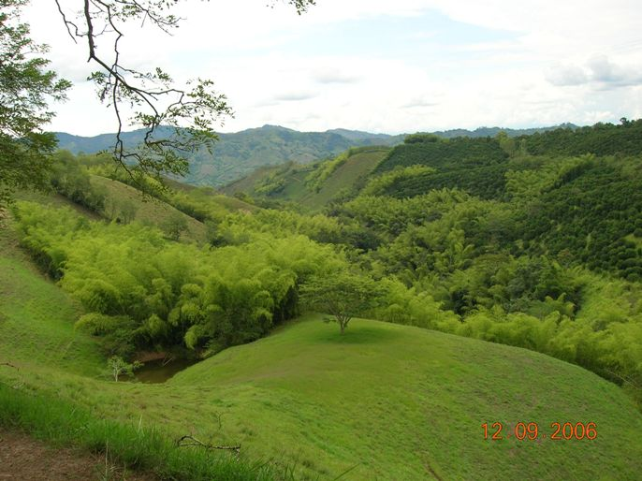

.
WHAT IS A GUADUA FORESTRY NUCLEOUS ?
It is the voluntary forestry organization of the guadua plantations into an area united by homogeneous characteristics or by geographical factors using sustainable practices to improve supply and generate benefits

Slide 8
Organizational Chart of the GFNLE
Colombian Bamboo Society CBS
Forestry Engineer and/or technologist or
Research Groups
Local and Environmental Authority
Dealers
Forestry Operator
Owners
Transporters
Harvesters and culm carriers
Farm Managers

Slide 9
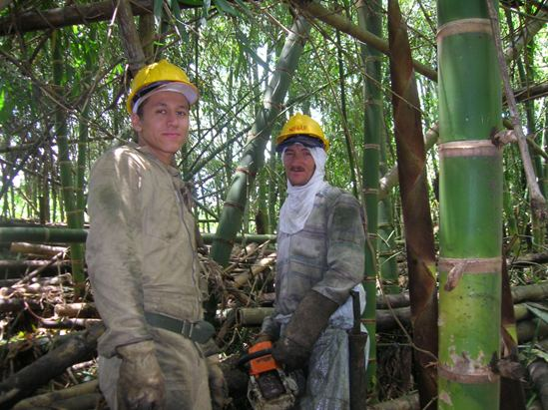
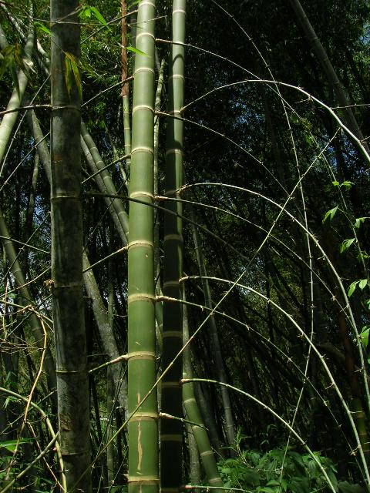
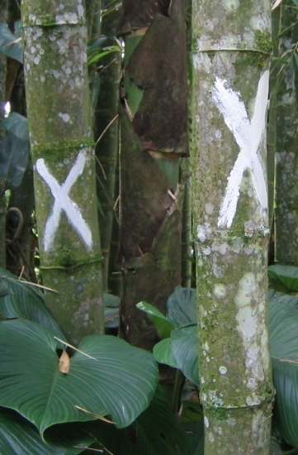
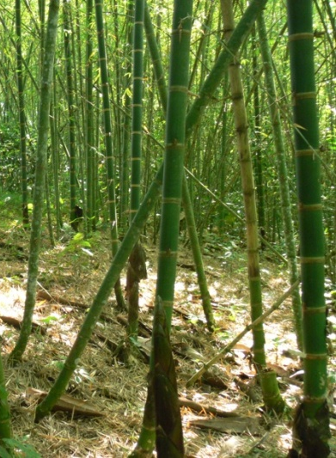
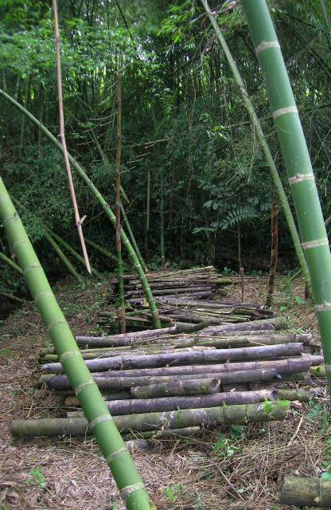
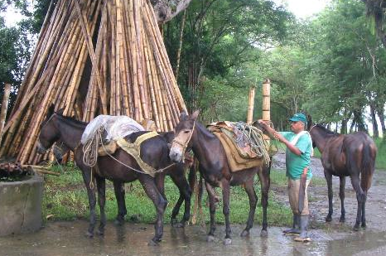

WORK TEAM & ACTIVITIES
TEAM
Forestry Operator 1
Harvesters 2
Guadua culm carriers 2
TOTAL PEOPLE 5
ACTIVITIES
Forest exploitation/harvesting plan and permit
Weed Control
Elimination of thorny branches
Elimination & Extraction of low quality culms
Marking

Slide 10
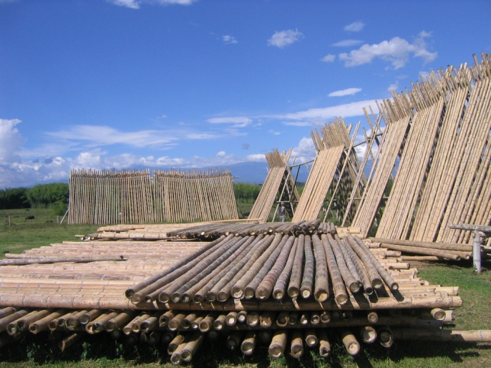
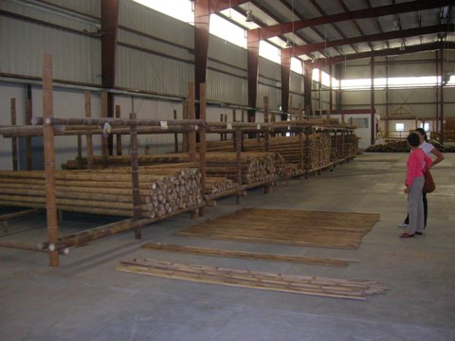
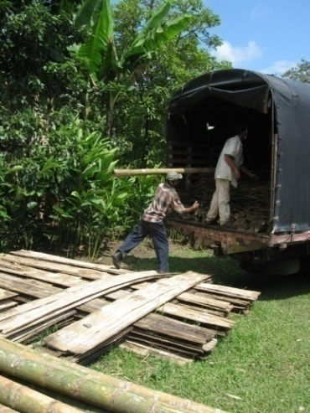
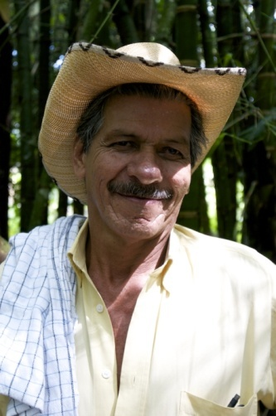
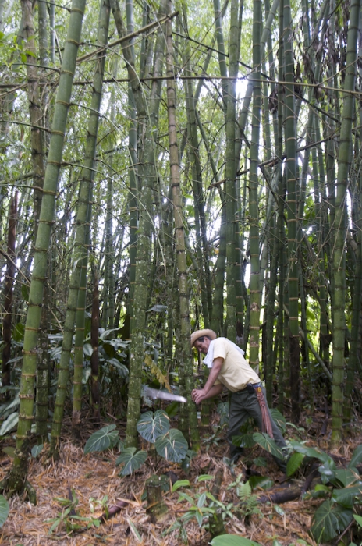
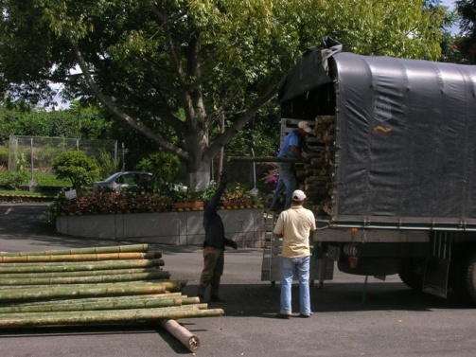
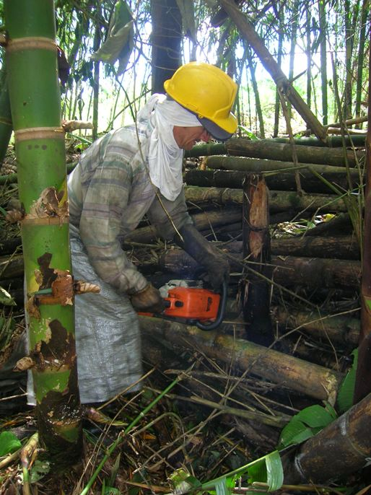
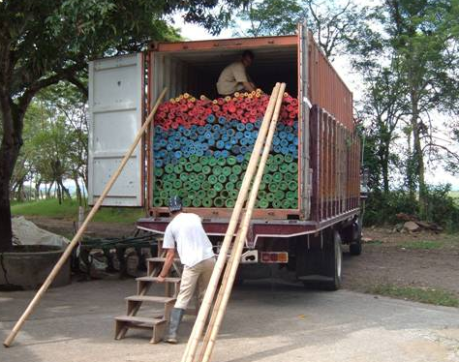

ACTIVITIES ....
Harvesting
Correcting culms
Transportation & storage
Commercialization

Slide 11
ACHIEVEMENTS
Environmental
Social
Economic
Improve the
environmental offer in
zone.
Preserve and reforest
the watershed in the
area of GFNLE.
Minimize
environmental impacts.
Identify & protect
fauna and flora.
Bring together and educate
farm owners.
Generate employment
sources.
Strengthen the principle of
association.
Exchange knowledge.
Train communities in
environmental education
and in the sustainable
management of guaduales.
Aggregate value.
Higher productivity and
profitability for the owner.
Supply a high quality
raw material for
different processes.
Supply quality guadua to
the Guadua chain.
Consolidate new
markets.

Slide 12
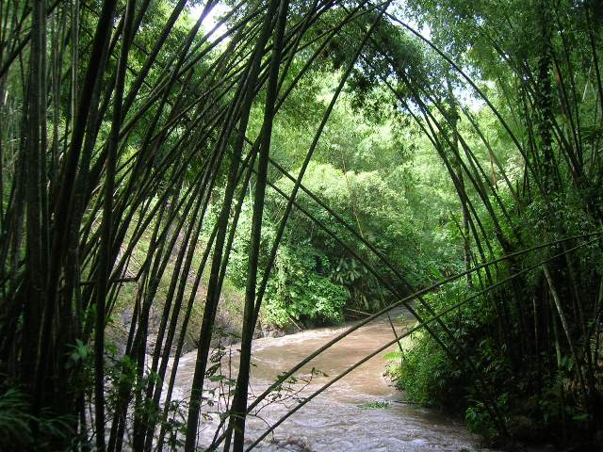
Other Environmental Benefits
  Identify and preserve the genetic biotypes inside the GFNLE.
  Preserve endemic and endangered species from the region in the GFNLE.
  Help research students measure environmental benefits of guaduales so that the nucleous can be eligible for clean development mechanism compensation in the future.
  Reforest the gaps along creeks and rivers with Guadua plantlets to improve the biological corridors inside the GFNLE.

Slide 13
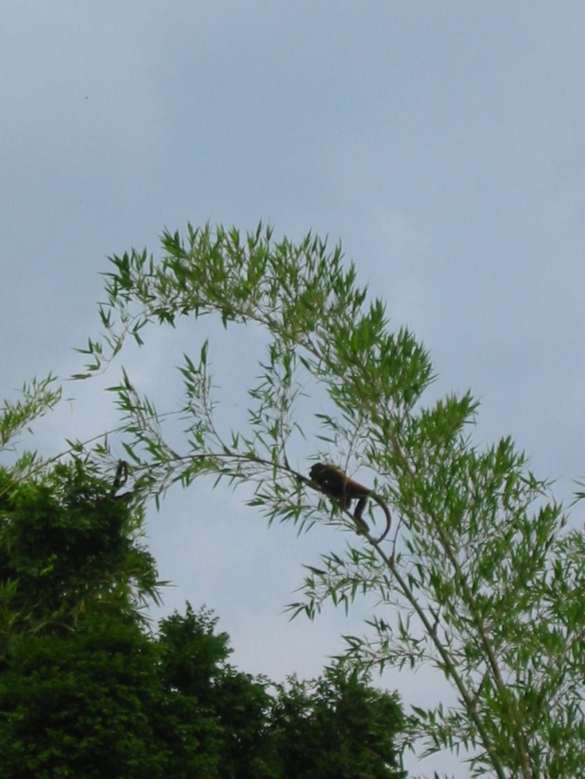
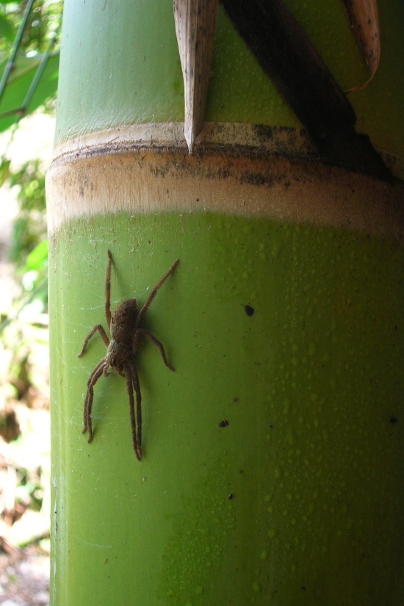
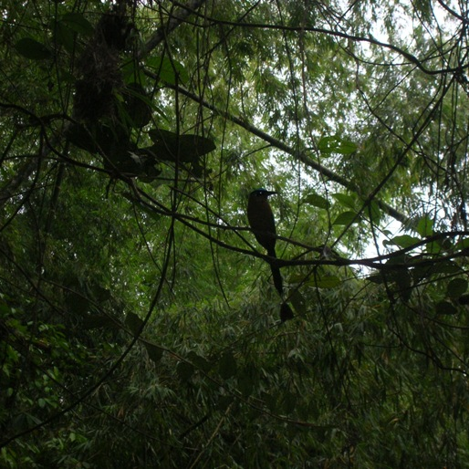
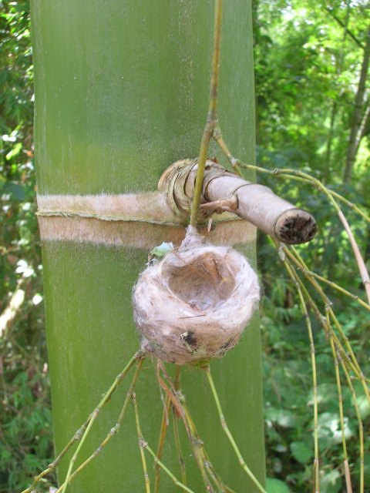
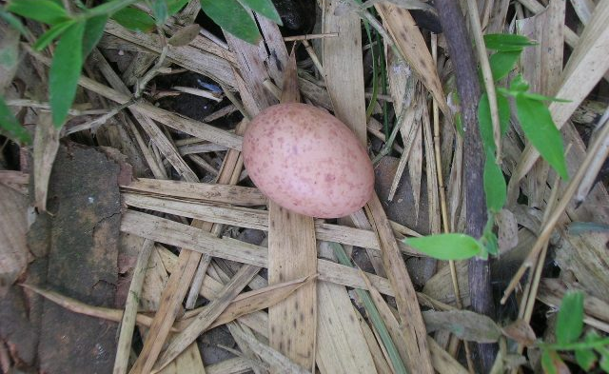
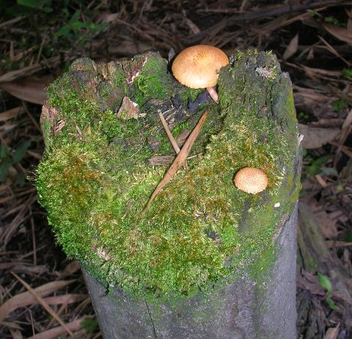
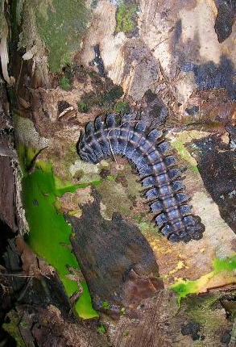
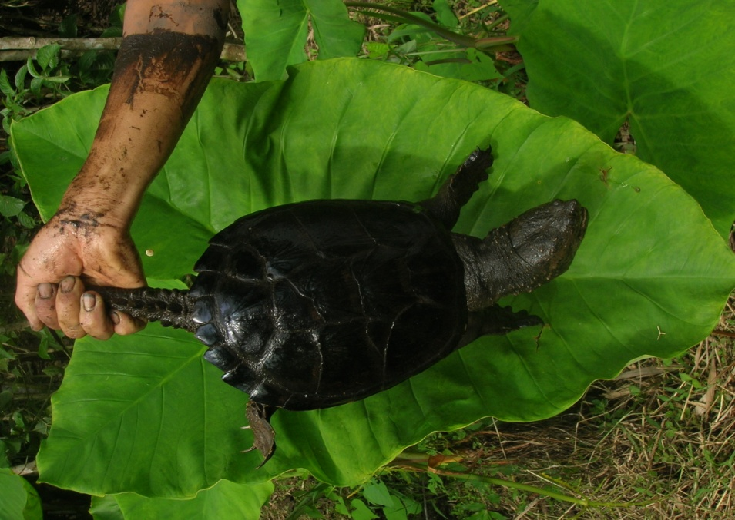
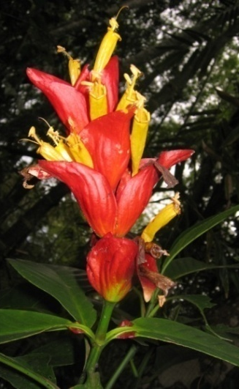
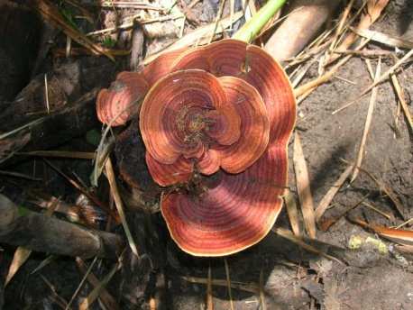
COLOMBIAN GUADUA BIODIVERSITY

Slide 14
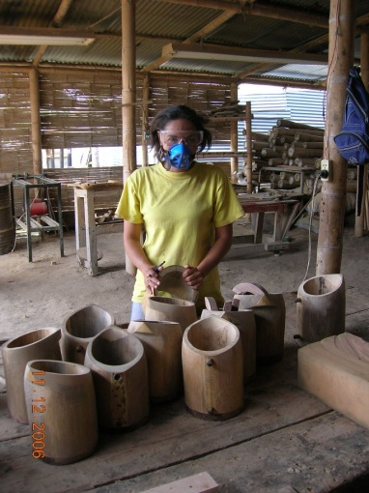
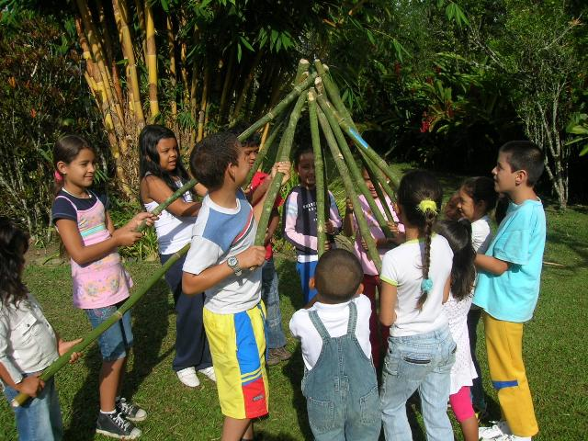
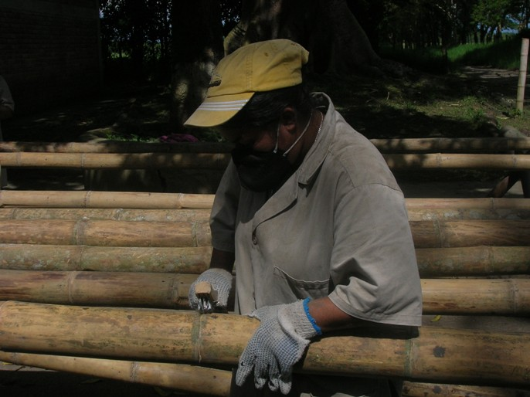
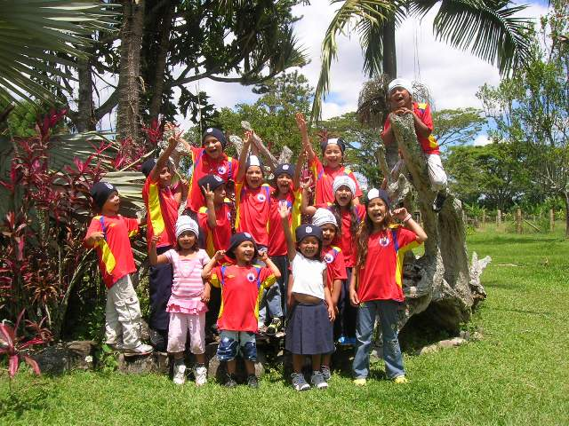
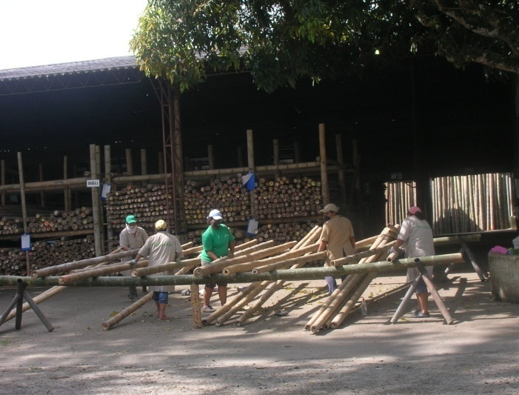

Other Social Benefits
Promote a handcraft center for women with the local government.
Give the children at the Santa Sofia School environmental education to develop a shared vision of sustainability for the area.

Slide 15
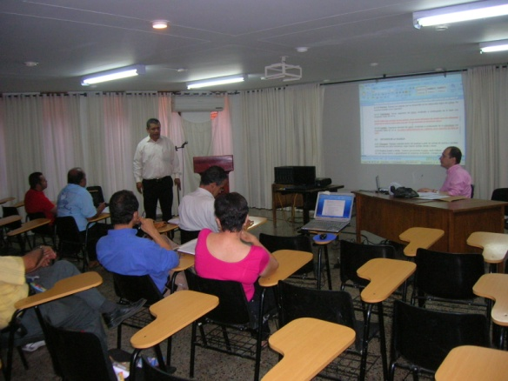
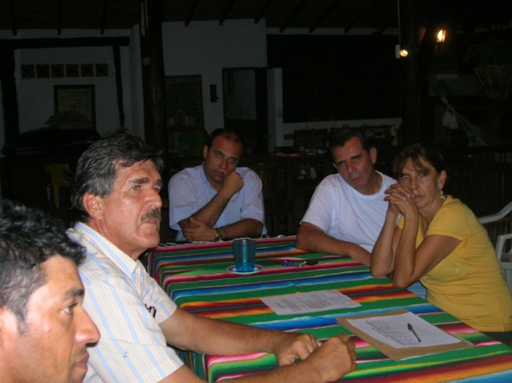
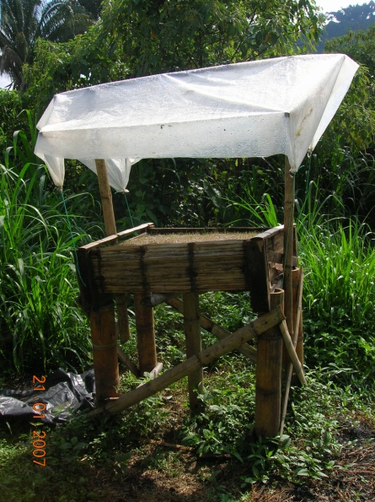

Conduct training workshops to generate awareness about the Colombian technical guadua standards – NTC.
Strengthen the principles of association among the members of the GFNLE to carry out community work.
Rescue traditional uses of guadua in the area through the permanent availability of guadua culms.

Slide 16

Other Economic Benefits
ACTOR | *BEFORE GFNLE | AFTER GFNLE
FARM OWNER | 10 % | 37 %
LABOR INTENSIVE TASKS | 43 % | 35 %
TRANSPORTATION | 38 % | 25 %
COMMERCIALIZATION | 9 % | 3 %
*According to Botero et al. 2006
We are part of the training and assistance by the Forestry project FLEGT-Colombia (2007-2010) to acquire voluntary forestry certification and legal timber.
Commercial agreements were signed with local and national dealers and members of the CBS to guarantee the custody chain in the certification processes.

Slide 17
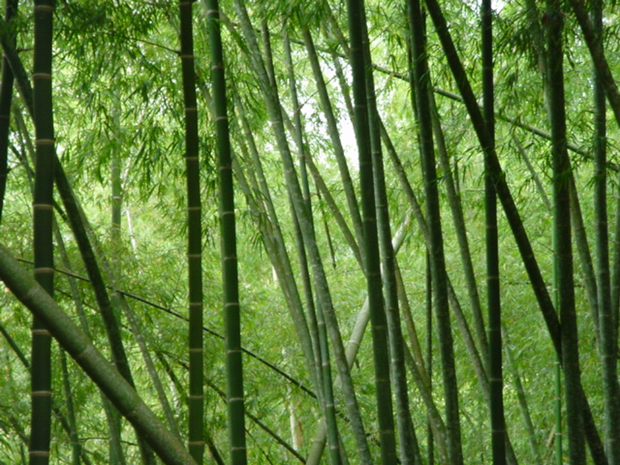

We are working with a resource that involves culture, protects natural environments, and alleviates climatic changes.
Simon Velez, a Colombian architect, understood the potential and value of Guadua´s characteristics, and subsequently developed building techniques that earned him the Prince Claus award.

Slide 18








THANK YOU!!
ขอบคุณ!!

