Slide 1
Sustainable Utilization of bamboo for pulp and paper manufacturing in Thailand
VIII World bamboo congress
September 18, 2009
By
Ratana Mormanee
Forest research and development bureau Royal forest department Thailand
Notes:
The topic of my talk is “Sustainable Utilization of bamboo for pulp and paper manufacturing in Thailand” Now let me begin by explaining about bamboo utilization for Thai-people.

Slide 2
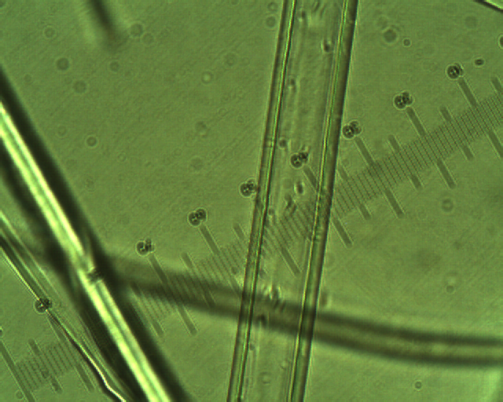
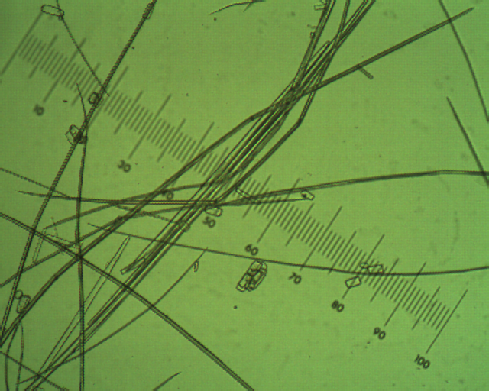
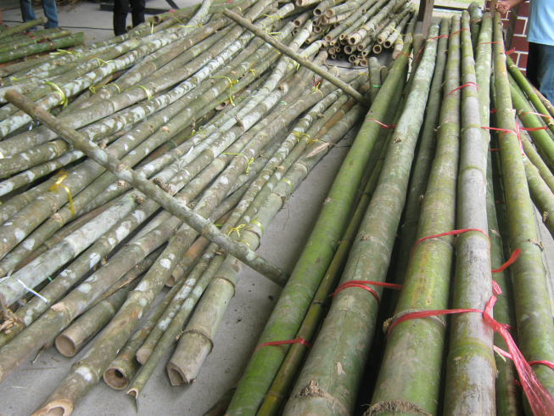

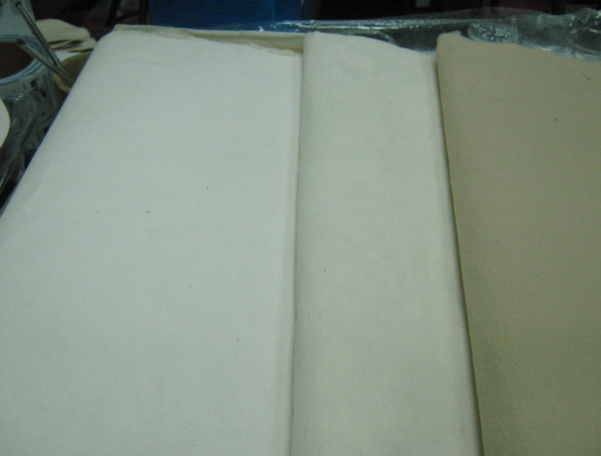
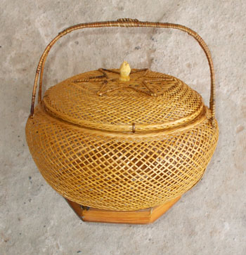
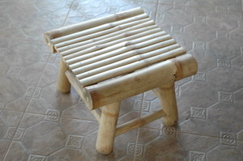
Notes:
All parts of bamboo give advantage to human, example for food, construction and especially for industry such as basket, chopstick and paper. In Thailand we now found It’s about 13 genus with 60 species. There are different in Texture and also I’ve heard for long time . Bamboo pulp is excellence but when we look at fiber dimention we found that there ‘re different in fiber length and fiber wall Thickness. And moreover, a process and a condition for cooking also effect to paper quality.

Slide 3
Objectives
The main purpose of the project is grouping bamboo species that it can be found in the north of Thailand for utilization in pulp and paper quality. It’s results initially decide to extension long- term plant.
Notes:
In this project, I would like to focus on raw material for pulp and paper. The main purpose of the project is find out group of bamboo species that it’s suitable for pulp and paper manufacturing.

Slide 4
Step method
To develop bamboo pulp
To examine pulp and paper quality
To compare pulp quality of various bamboo species
Notes:
Let’s turn now to the step method

Slide 5
process | condition
Sulfate process Chemical : NaOH, NaS.9H₂O | T=170ºC, Time=120 min Sulfidity 25% Active alkali 14, 16, 18, 20% Wood per liquor ratio 1:4
Soda process Chemical : NaOH | T=150ºC, Time= 90 min NaOH solution con. 10, 15, 20, 25% Wood per liquor ratio 1:4
Formacell process Chemical : CH3COOH, FOH | T=160ºC,Time=120min Water content 5, 10, 15, 20% Wood per liquor ratio 1:7, FOH=10%

Slide 6
results
Different method pulping from Cephalostachyum vergatum Kurz
Show the paper quality under standard method
Comparing bamboo pulp that prepare from 13 bamboo species.

Slide 10
Notes:
The next, I would like to continue on the physical properties of paper from formacell pulp, sulfate pulp and soda pulp.
Let’s look now at this Figure, At temperature of 165oC, 15% of water content,it should be give good quality of paper. Why is this condition good? Because the significance of physical properties is higher breaking length, bursting strength, tearing strength and also higher brightness.

Slide 11
Notes:
Next look at Figure show physical properties of bamboo paper(C.vergatum) from sulfate process at different freeness. It can be seen that at 16% and 18% active alkali have a relatively similarly, higher physical properties and brightness.

Slide 12
Notes:
And now we’ll move on to physical properties of bamboo paper from soda process ,It can be seen that at 10% of sodium hydroxide solution and a wood per liquor ratio of 1:3 gives good quality of paper.

Slide 13
Notes:
Next Let’s consider this in more detail of the different between process. This chat show effect of fiber strength of bamboo on tearing-tensile relationship. These two pulps are kraft pulp and soda pulp. Why it’s important? The higher level of beating may reflect a drop in fiber length. As a result, the amount of fiber fracture is occuring during a tearing failure and if it’s shortened any further by beating. This could well lead to increase in fiber pull-out, It means increase in Tensile strength.

Slide 14
Notes:
Next, I’d like to expand on comparing of soda pulp from 13 species of bamboo. Let look at the Figure show pulp properties of different bamboo species on yield, kappa number and brightness. It’s about 5 species of bamboo provide high yield and high brightness.

Slide 15
Notes:
And let’s look at the figure show the quality of paper. It’s about 5 species of bamboo are significant of strength.

Slide 16
Conclusions
Bambusa logispiculata Kurz
Bambusa blumeana Schult
Thyrostachys siamensis Gamble
Bambusa arundinaceus Wild
Cephalostachyum virgatum Kurz
There are suitable for pulp and paper manufacturing.
Notes:
From the results, we can conclude that the soda process is preferable for bamboo pulping. It’s a known process and 5 species of bamboo that found in the north of Thailand are Bambusa logispiculata Kurz, Bambusa blumeana Schult,Thyrostachys siamensis Gamble, Bambusa arundinaceus Wild, Cephalostachyum virgatum Kurz, which is suitable for pulp and paper manufacturing.

Slide 17
Testing Method
Parameter | TAPPI and SCAN standards testing
Kappa number ISO Brightness % Yield Beating Time Freeness Thickness and Apparent density Breaking Length Tear Factor Burst Factor | T236m-60 SCAN-P3; 62 weight SCAN-C24; 67 T227 os-68 T411 os-68 SCAN-P16; 65 SCAN-P11; 64 T403 ts-63
Notes:
This slide shows standard test method use in this experiment.

Slide 18
Vocabulary/Parameter
Pulp quality may represent in Yield, Kappa number, resistant, Degree of polymerization and Brightness etc.
Physical properties of paper represent in Tensile strength, bursting strength and Tearing strength and Brightness etc.
Brightness is the percentage reflectance of blue light only at a wavelength of 457 nm. The standards are per TAPPI T 452
Tensile Strength is indicative of fiber strength, fiber bonding and fiber length.(TAPPI T 494)
Bursting strength tells how much pressure paper can tolerate before rupture.(TAPPI T 403)
Tearing Resistance/strengths is the ability of the paper to withstand any tearing force (expressed in cN, TAPPI T 414)
Canadian Standard Freeness (CSF) is an arbitrary measure of the drainage properties of stock under specified conditions.

Slide 19
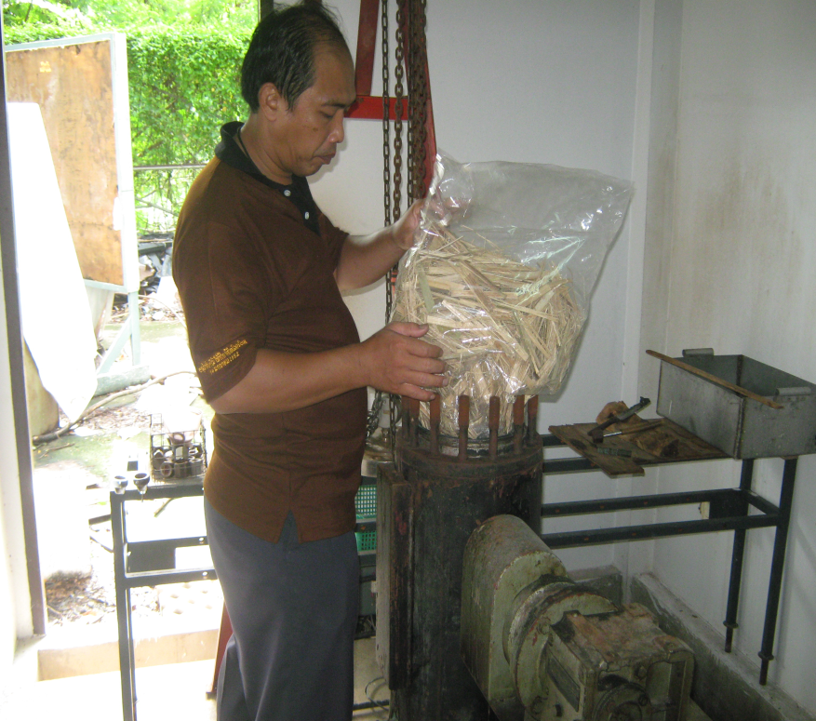
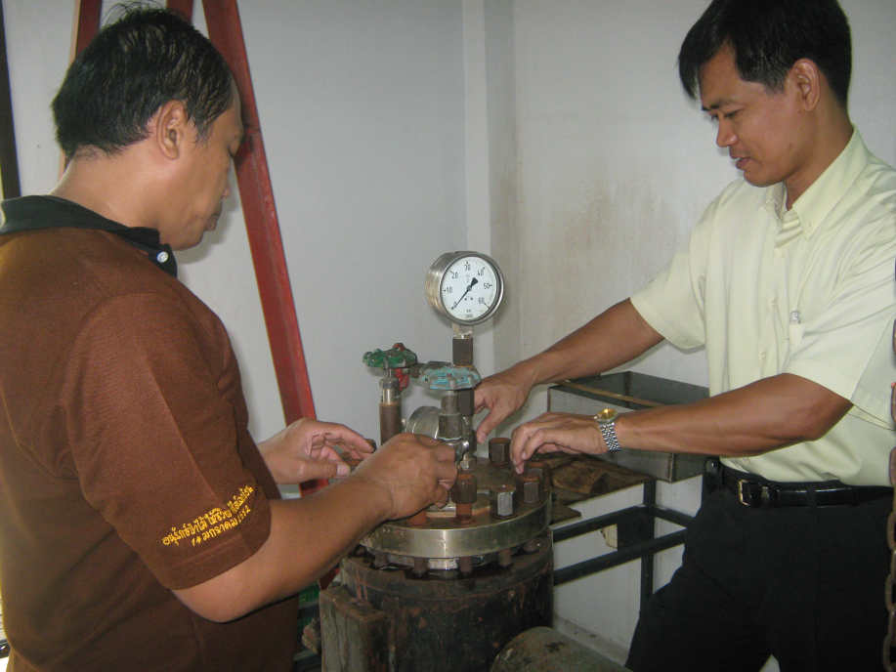
Our Group

Slide 20
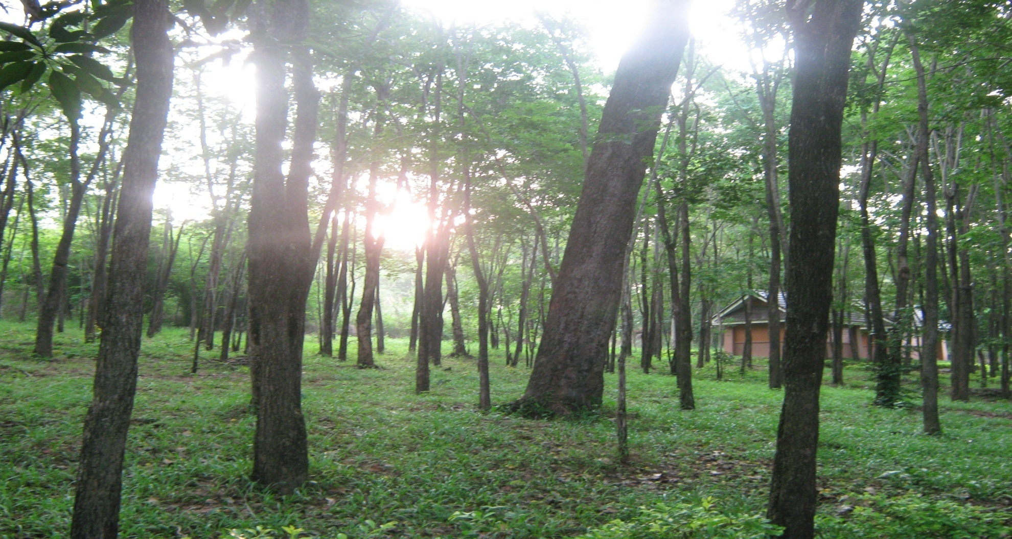
Thank you for your attention

Slide 22
Notes:
Now we’ll move on to Figure 1 show effect of % water content on percentage of yield, Kappa number and Brightness of formacell pulping at formic acid of 10%, at temperature of 160oC, 2 hrs of retention time and wood pr liquor ratio of 1:7 . You can see at 15% water content give good condition with high brightness

Slide 23
Sulfate pulping of bamboo
Notes:
And the Figure 2 which give information about sulfate pulping. The graph shows the percentage of yield, kappa number and brightness. It is obvious that 18% active alkali is the best condition for sulfate.

Slide 24
Soda pulping of bamboo
%Kappa number
%Yield
% Brightness
Notes:
Let’s see the soda process. The graph compares cooking condition between wood per liquor ratio of 1:3 and 1:4. it can be seen that the ratio of 1:3, at 15%alkali give the highest brightness but at 10% alkali give highest yield.

