Slide 1
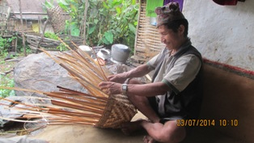
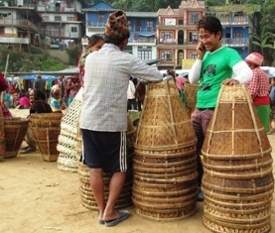
Importance of Bamboo in Poors' Livelihood in Nepal
Ms. Mathura Khanal
Expert-GESI, Governance and Livelihood
Rural Reconstruction Nepal/Multi Stakeholder Forestry Program

Slide 2
Outlines of Presentation
Introduction
Rationale of Research
Research Methodology
Findings of the Research
Discussion/Conclusion
Acknowledgement

Slide 3
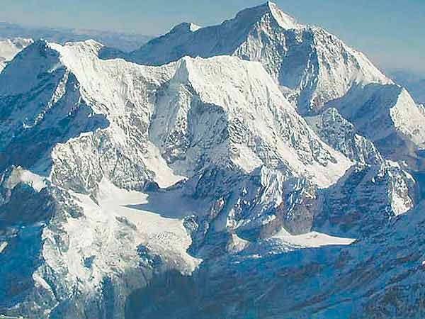
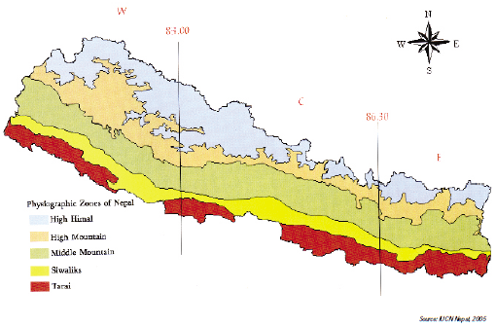
Nepal: Background
Small Himalayan country having area 147,181 km²
Altitudinal variation from 60 m to 8,848 m in very short distance; makes it rich in biodiversity

Slide 4
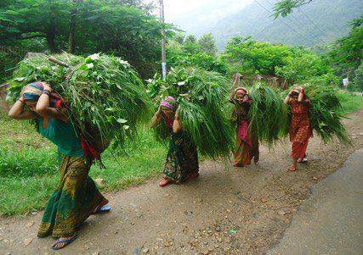
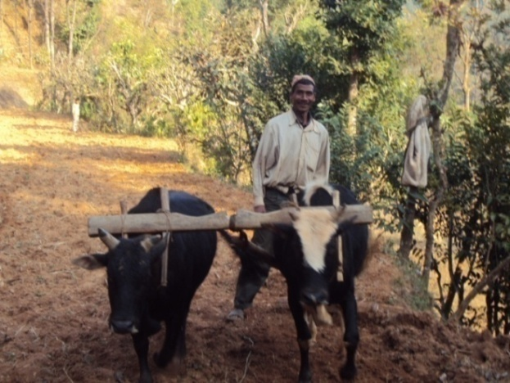
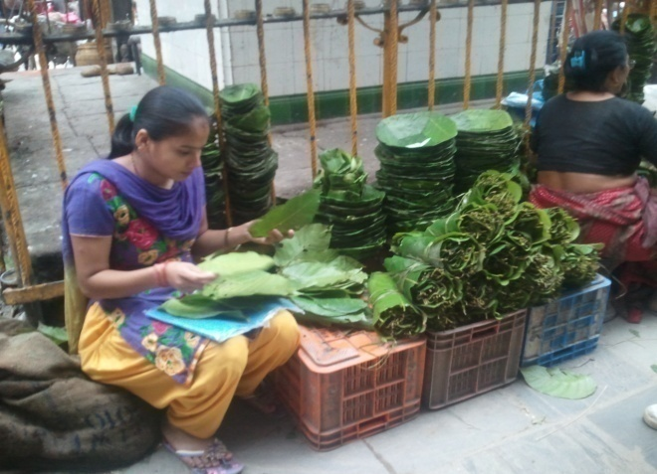
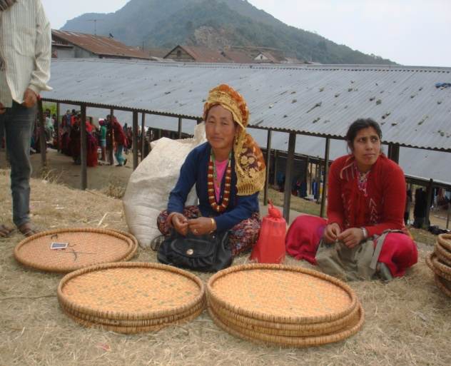
Livelihood
Population
Total: 26.6 million
Male: 12.9 million
Female: 13.7 million
(CBS, 2011)
More than 100 ethnic/caste groups with distinct dialects,cultural and religious practices
Forest is an integral part of the daily lives of the rural population.
Contributing major sources of subsistence for poor forest dependent community and income linked to NTFPs.
45% income with connection to the NTFPs which is about 15% of the forestry sector’s contribution to the GDP ( Edwards,1996).

Slide 5
Rationale of Research
Before prescribing specific management tools to resource managers, adaptive research must be carried out.
Most of the national level forest plans are focused on the tree and timber management plan only.
The roles of the community and women in regard to conservation and domestication of rare gifts of nature are ignored by the state.
There is fear from the loss of the biodiversity; and consequently the loss of the traditional knowledge and skills.
Despite Bamboo has many importance, management and commercial utilization aspects are not yet fully explored to its potential in Nepal.
To find out the status of the Bamboo Relations in the rural area in Koshi Hills.

Slide 6
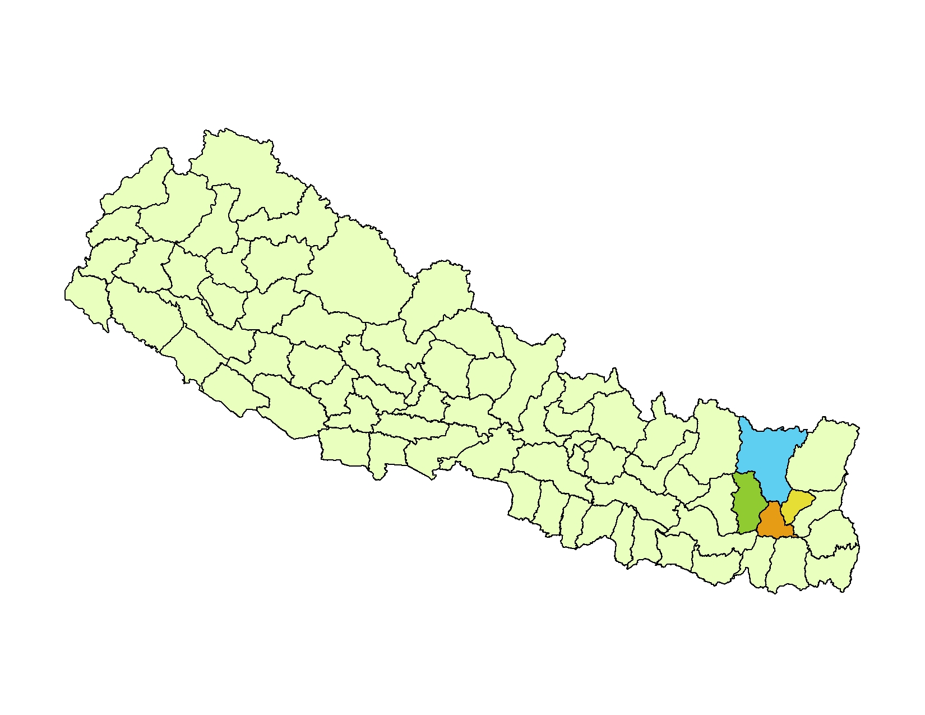
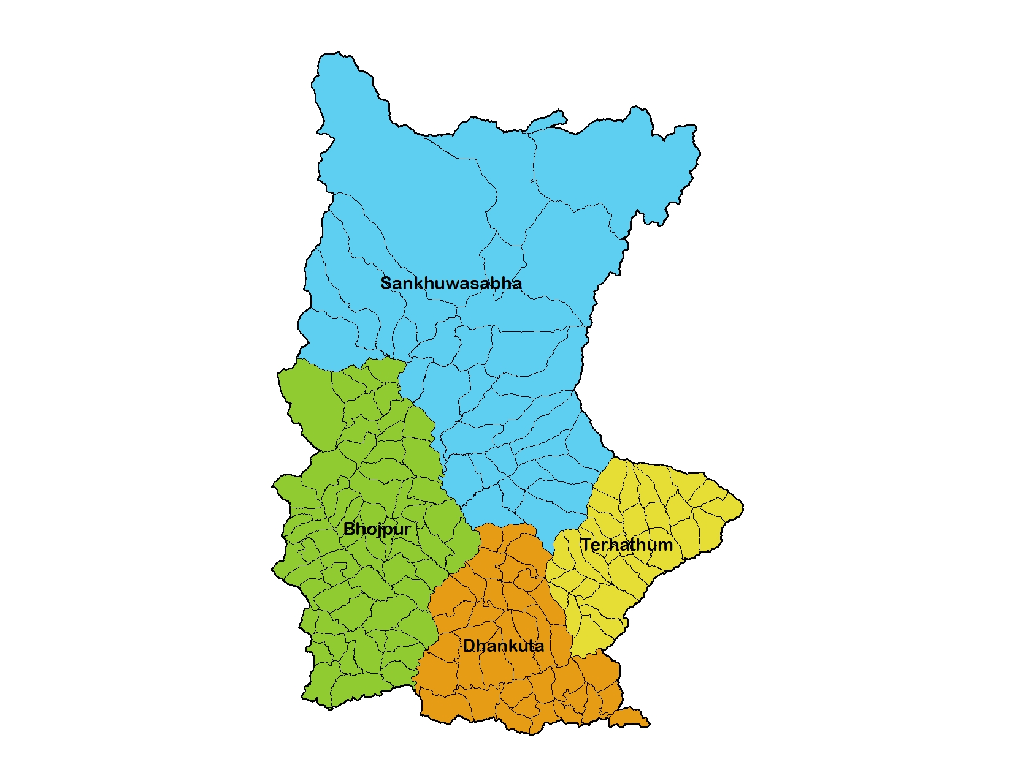

Slide 7
Introduction
Nepal is rich in bamboo species as 53 species of 12 genera bamboos are reported in Nepal (Das, 2002).
Mostly cultivated in private land, stream and riverbank as well as roadside, common land and somehow in natural forest.
Bamboos have historical and cultural connection in Nepalese society.
Every farmer has two to ten clump of bamboo in their private land as it is indispensable in their livelihood and used in almost all the aspects of life from birth, marriage to death.
Poor, Dalits and Ethnic communities are found more dependent on bamboo for their subsistence.

Slide 8
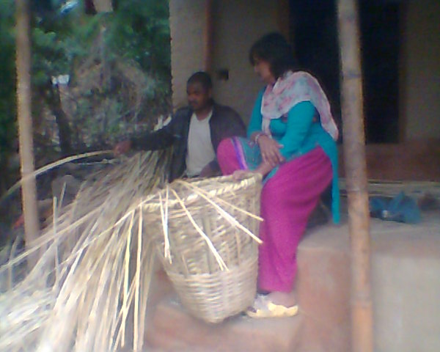
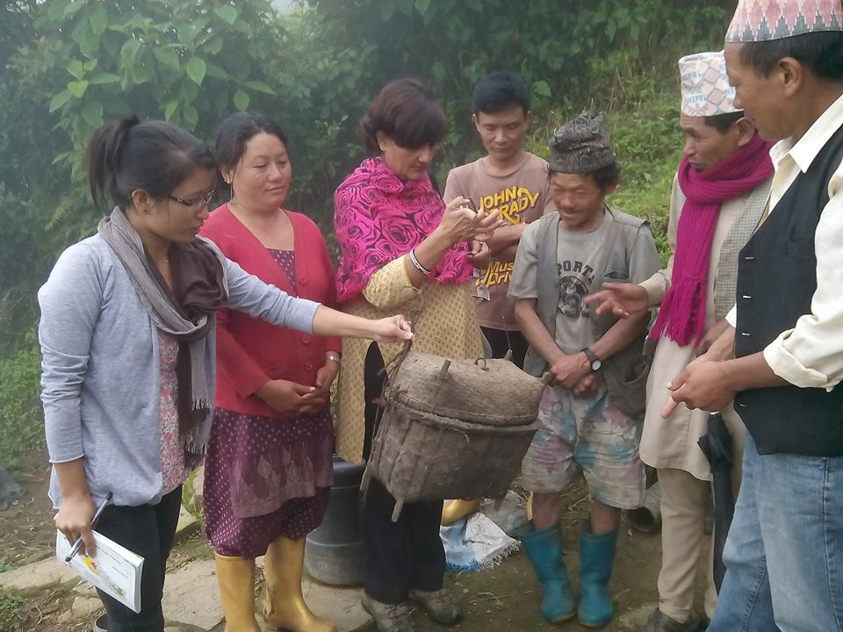
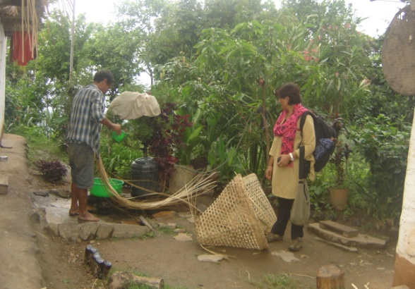
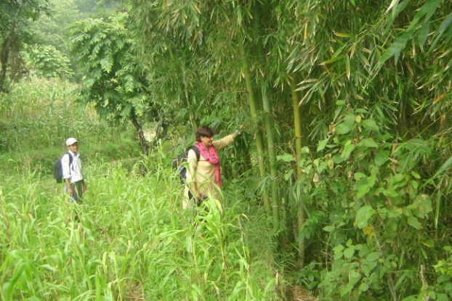
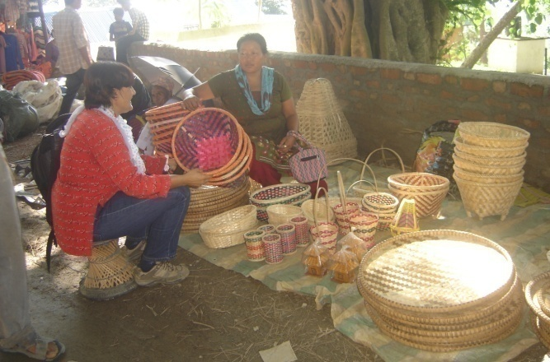
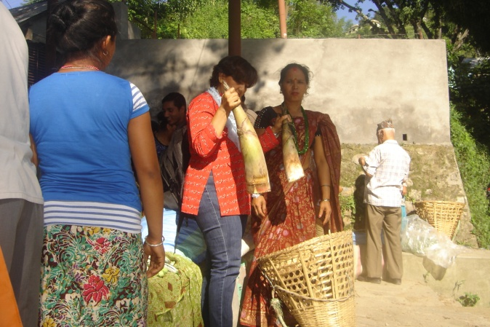
Research Methodology
Group Discussion
Household Survey
Private land Observation
Interview with entrepreneurs
Field Visit
In -depth Study
Data Storage and Analysis

Slide 9
Household Survey
Sample was taken using systematic method of sampling for which sampling interval was calculated as: K= N/n; where, K= sample interval, N=total population and n= sample population.
First sample (n₁) was taken randomly. The next sample was taken as n₁+5, second subsequently was 6 and similarly thereafter, results in total sample of 50 household from 251 households in Ghorlekharka VDC Dhankuta and 22 Household from Urathe CFUGs in Terhathum.
Microsoft excel was used for data analysis.

Slide 10
Findings of the Research
Types of Bamboo in the study area.
Male and Female Involvement in Bamboo business.
Caste based involvement in bamboo entrepreneur
How poor get benefits from Bamboo
Income from Bamboo
Attraction and Potentiality Bamboo.

Slide 11
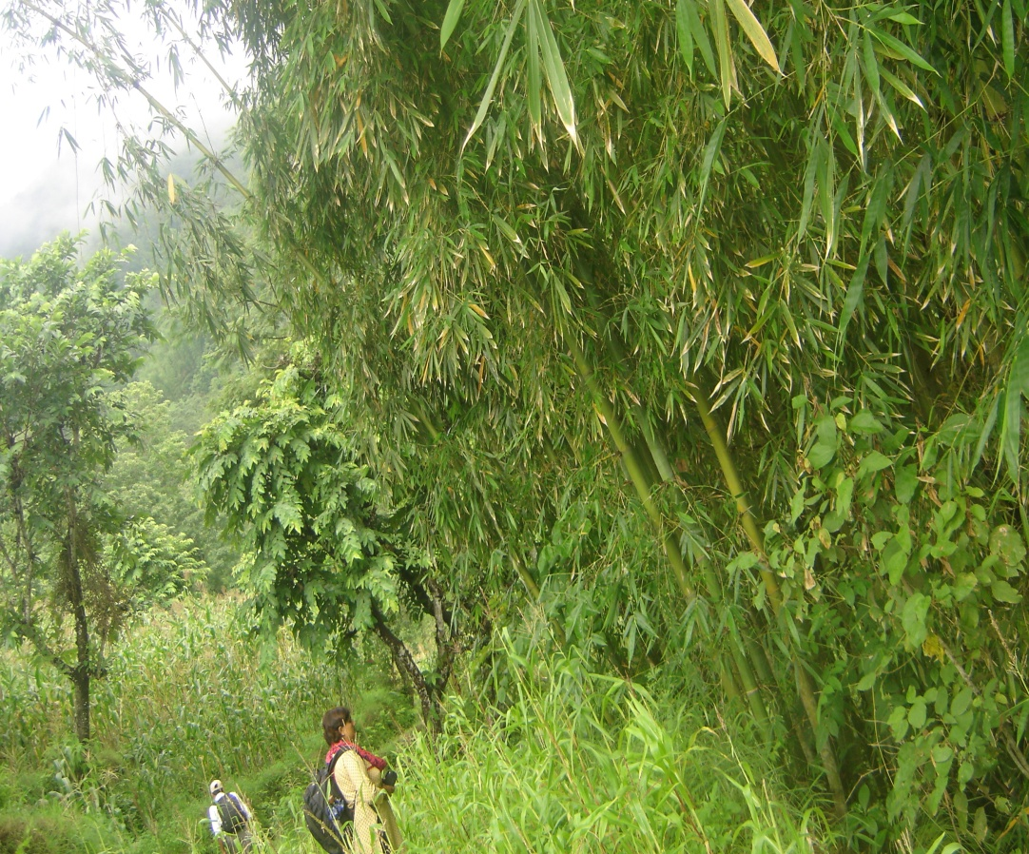
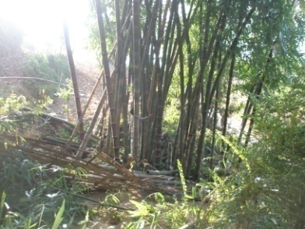
Bamboo Available in Khoshihill
Bambusa balcooa
Dendrocalamus hookerii

Slide 12
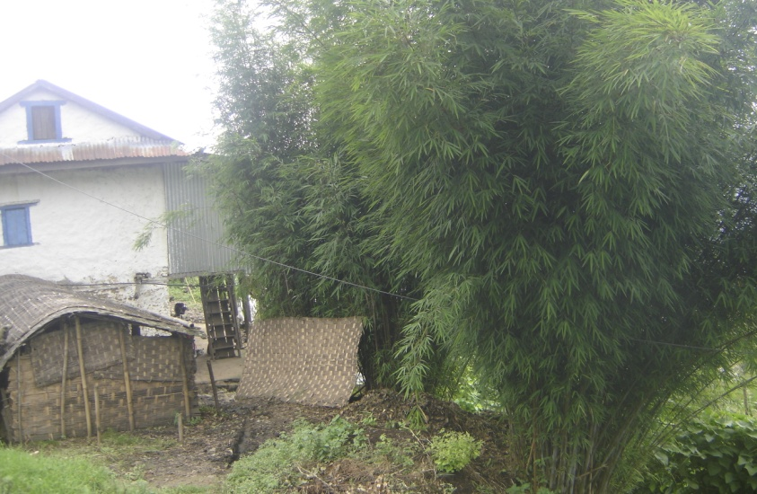
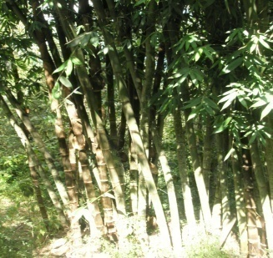
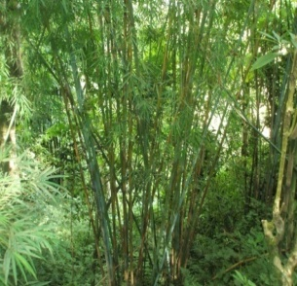
Dendrocalamus hamiltonii
Arundinari intermedia

Slide 13
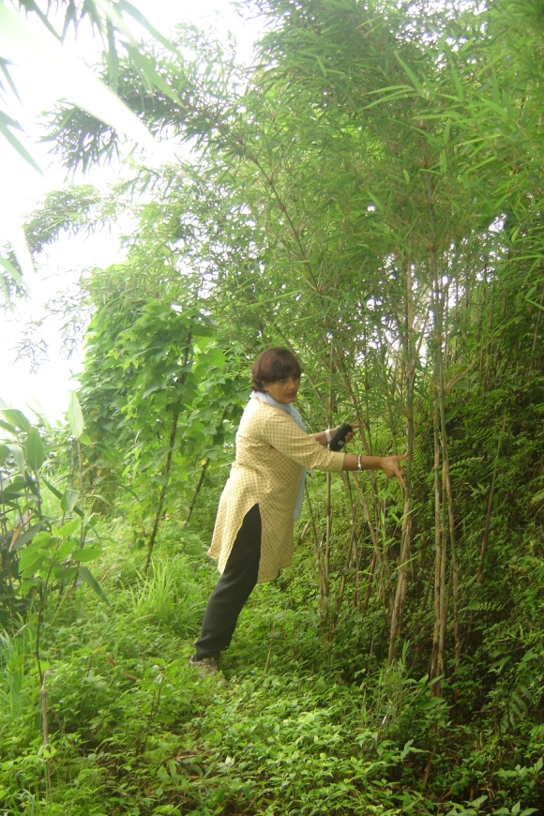
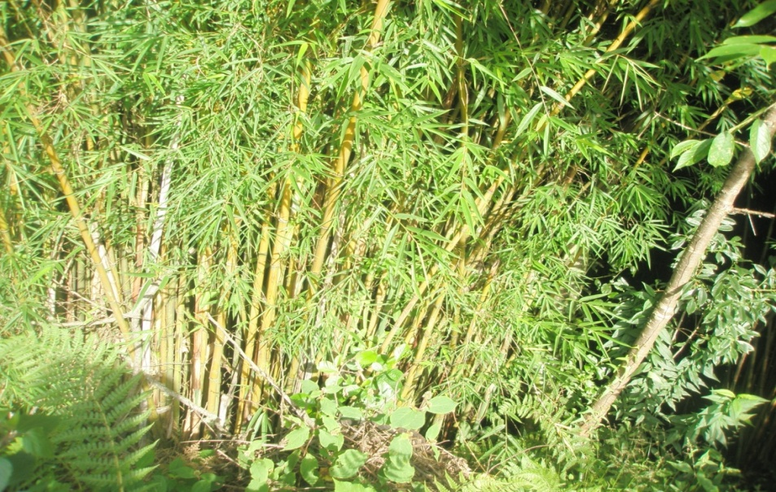
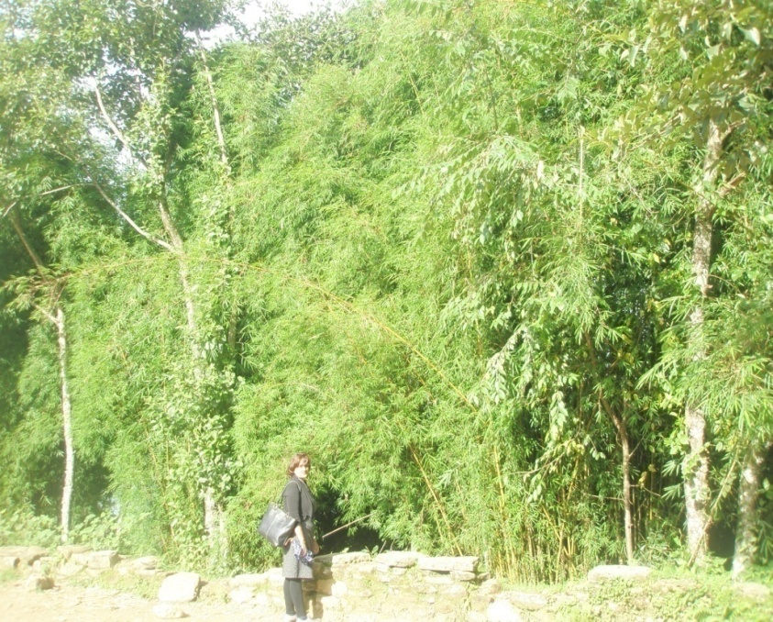
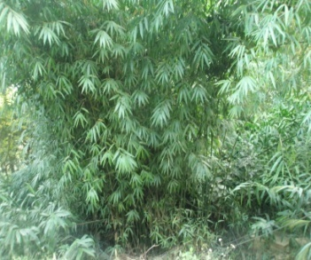
Yushania maling
Himalayacalamus hookerianus –Pareng /Padang
Dendrocalamus patellaris

Slide 14
Utilization of Bamboo
Bamboo
Nutrition
vegetable (Shoot)
Landslide/Gully control
Ritual/festival
clumps
Medicine
Root for typhoid
Leaves fodder
House construction, Furniture(stem)
Utensils-Basket, tray and decoration items

Slide 15
Involvement in Bamboo Enterprise

Slide 16
Caste and Poverty
Poor, Ethnic community and Dalits have insufficient land for bamboo plantation.
Their houses were found made by bamboo.
They have indigenous knowledge and skills to weave bamboo craft.
Dalits can sell their handcraft without any hesitation in touchable manner.
The land owner can provide bamboo without any provision of District Forest Office ( Bamboos are consider as grass by forest Law).
Many INGO/NGOs are focusing on bamboo enterprise in the study area.
Skilled persons can work anywhere and utilize their time in productive way.
They can earn more from this business in comparison to agricultural business

Slide 17
How Poor,Ethnic Groups and Dalits are Benefited
They are able to make their house and sheds as it is cheap in rural areas.
They can weave the utensil in leisure time and can sell easily in near by market
Female sell bamboo sprout which has high demand in local market.
Cottage industries/Bamboo entrepreneurs are providing jobs to the skilled male and female.
Female are involving to prepared modern commodities of bamboo and earning for their livelihood.
Women were found more active in selling and saving activities for better livelihood and their children educations.

Slide 18
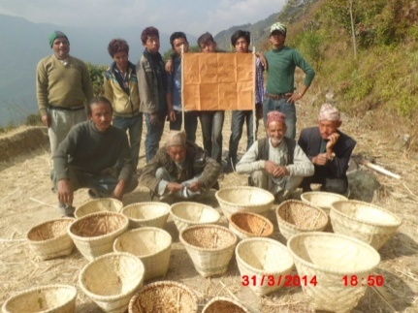
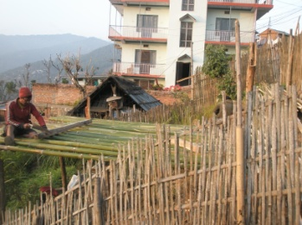
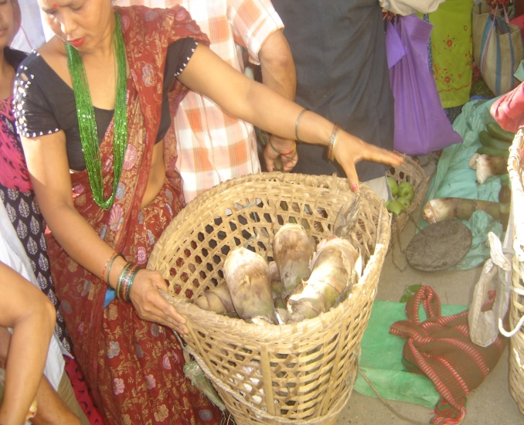
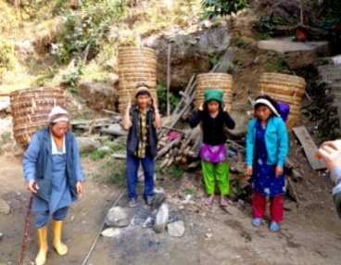
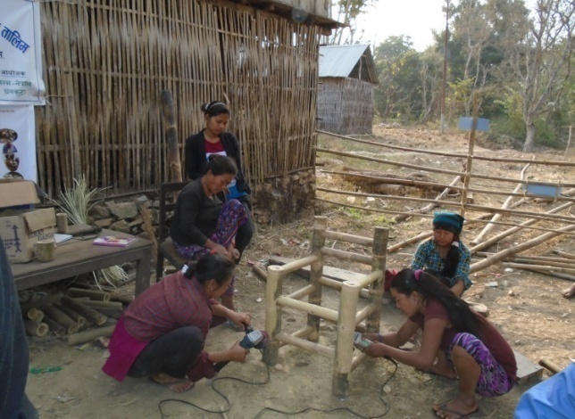
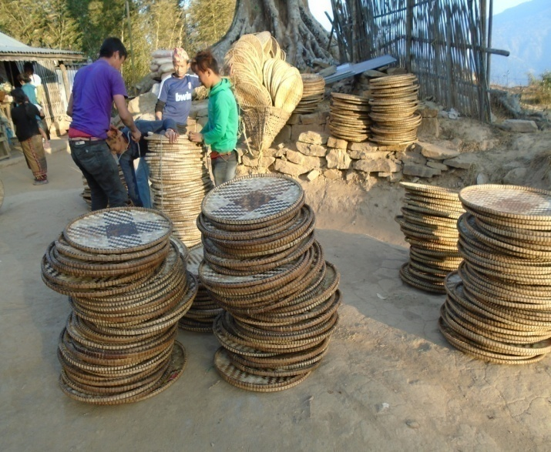

Slide 19
Potentiality of Bamboo Enterprises in Nepal
There is high demand of modern commodity of bamboo.
Traditional bamboo craftspeople can easily catch up the modern commodities.
Abundance of bamboo species in the country.
The study found that more than 80% of bamboo clump are untouched yet in the rural area due to inaccessibility.
Road access are being made in rural areas of Nepal that will change the scenario in every aspects.
Bamboo utensils are essential for subsistence as they are cheap and durable.
Climate change is undermining people's ability to grow food.
Use of bamboos has been increased to make houses after earthquake.

Slide 20
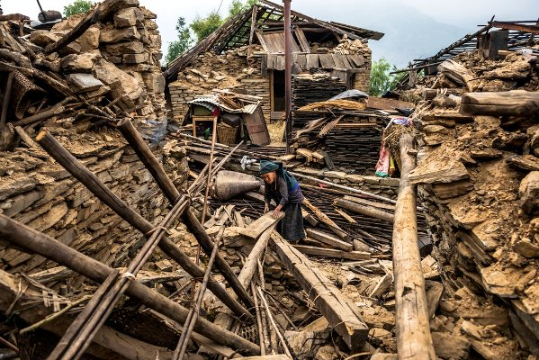
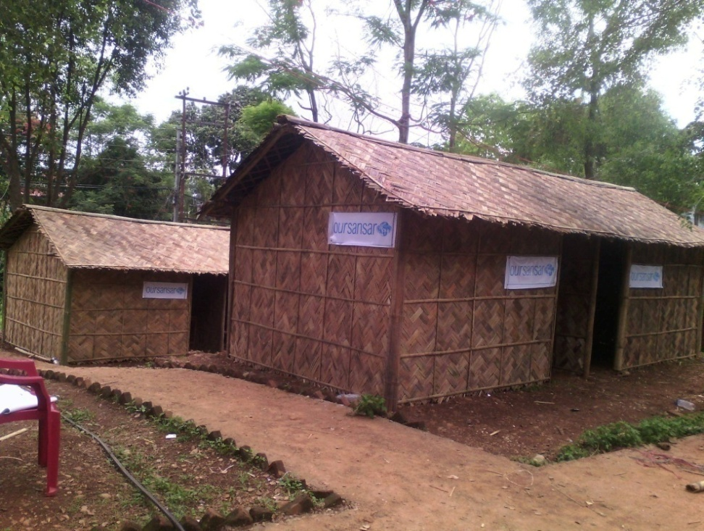
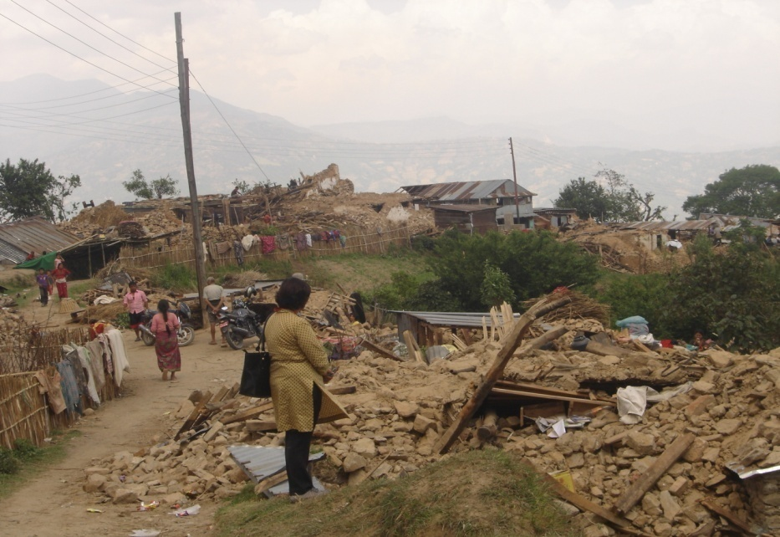
Bamboo for poor's after earthquake in Nepal

Slide 21
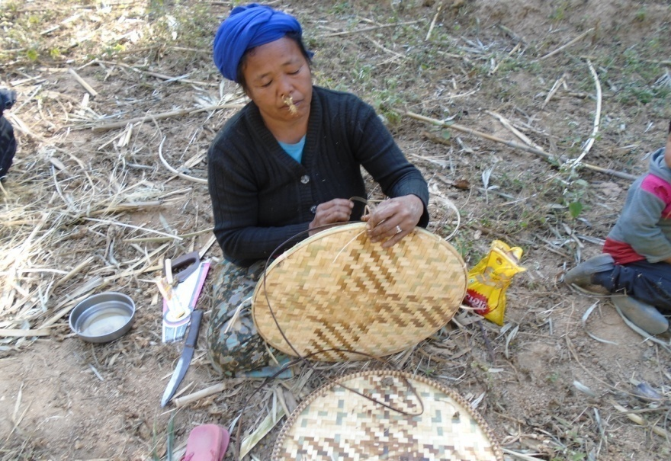
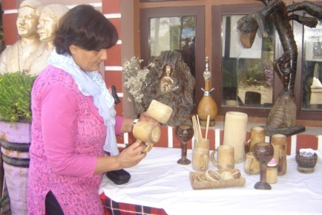
RRN/MSFP Supports to Poor and Marginalized Community
Provide trainings to promote knowledge and skills for modern commodity.
Provide Equipments to make the task easy and faster.
Emphasis for women involvement.
Support to establish bamboo group enterprise through cash.
Support to establish cooperatives through seed money.
Support in marketing through tread fare.

Slide 22
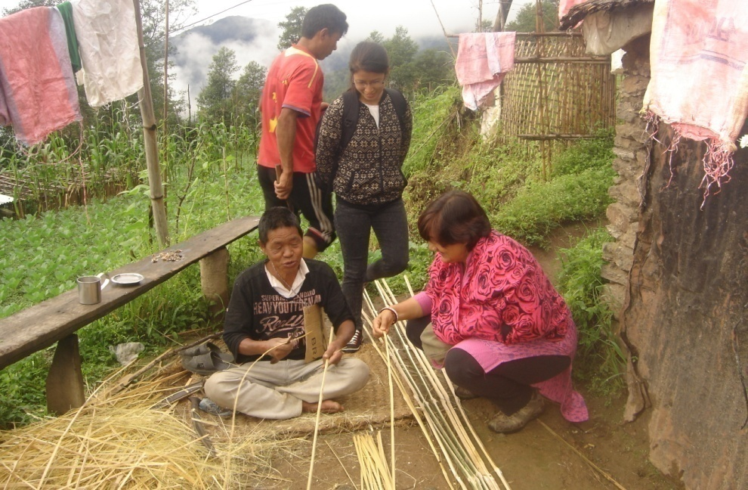
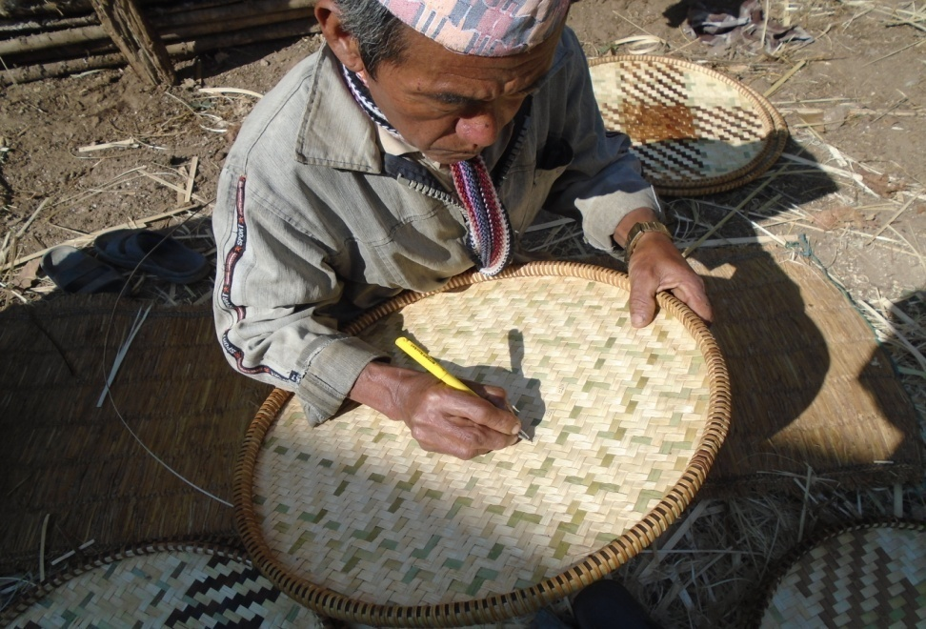
Case Study
The president of Simaldhunga Nangla Udhog Bhim Bhahadur Limbu and his partners from Terhathum district say; "We can get bamboo without any difficulties from forest as well as land owners and can sell any part of the country any time because bamboo is considered as grass. NTFPs and other wood based products need more procedure that we are not able to buy and sell due to forest law of Nepal. We have less land and no irrigation facilities that could support us hardly for four months.
Due to less rainfall in this decade we are unable to cultivate food stuff even in the rainy season and getting less product from our farmland though we spent more time due to lack of such opportunities. We can weave bamboo utensils in our leisure time though we are in old aged.
We can earn about 6000/- NRs in a week that is sufficient to buy food stuffs and fee for school children".

Slide 23
Discusion/Conclusion
Plenty of bamboo species are available in the study area.
Study found that women from poor family are interested in bamboo weaving enterprises.
Bamboo craft making is only the alternative income source to cope with this food insecurity situation as it is the traditional occupation of Ethnic and Dalits.
There is high demand of modern bamboo crafts due to urbanization in the country.
Bamboo is playing crucial role to uplift the economic and educational status of the deprived people in study area.

Slide 24
Recommendation
Government should provide adequate support (Promotion trainings, skills, additional knowledge for marketing with proper policies).
INGOs/NGOs should work without any duplication making strong coordination with related line agencies
Integrated effort is required to develop bamboo entrepreneurship, promotion of cottage industries and conservation of traditional knowledge system to reduce the poverty in Nepal.
Sustainable utilization is must for the benefit of the society and nation.

Slide 25
Acknowledgements
I am grateful to the local people who devoted their precious time and shared their knowledge during my field visit.
I also acknowledge the encouragement rendered by my family members and RRN/MSFP.
I am thankful to conference authority to provide me this opportunity to deliver my research findings.
Thank you very much for your kind attention to the audience.

